Slide 1


Develop your teaching your way
Bridging AI and OER: Curate, Adapt, and Create OERs
Vincent Granito, Ph.D.
www.onehe.org

Slide 2


Co-Chair Campus-Wide AI Task Force
Faculty Chair, Teaching and Learning Center
AI/OER Fellowship: Institute for the Study of Knowledge Management in Education (ISKME)
https://oercommons.org/hubs/ai-in-oer
Search: “OER Commons AI OER Hub”

Slide 3
Open educational resources (OER) are teaching, learning, ​and research resources that reside in the public domain ​
or have been released under an intellectual property ​^{license that permits their} ​free use and re-purposing by others
^{(OER Commons, ISKME)} ​
^{OER include:}​
^{full courses,} ​
^{course materials,} ​
^{modules,} ​
^{textbooks,} ​
^{streaming videos,} ​
^{tests,} ​
^{software,} ​
any other tools, materials, or techniques used to support access to knowledge ​

Slide 4
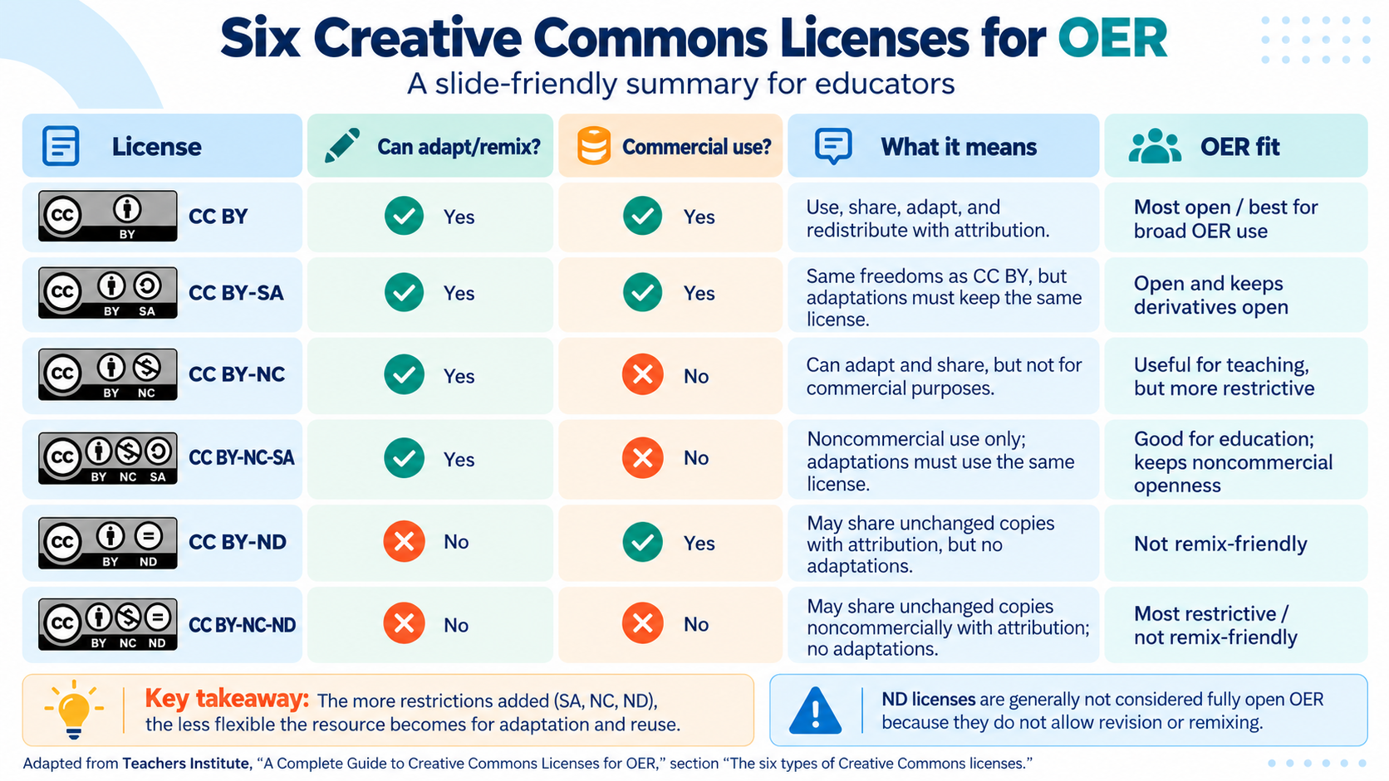

Slide 5
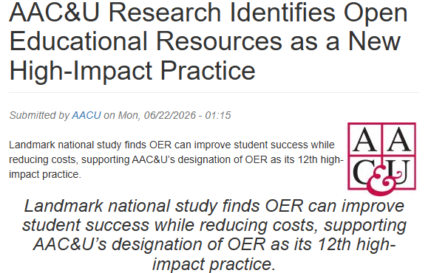

Slide 6
AAC&U OER Study
Almost 700,000 students
Different Types of Colleges & Universities

Slide 7
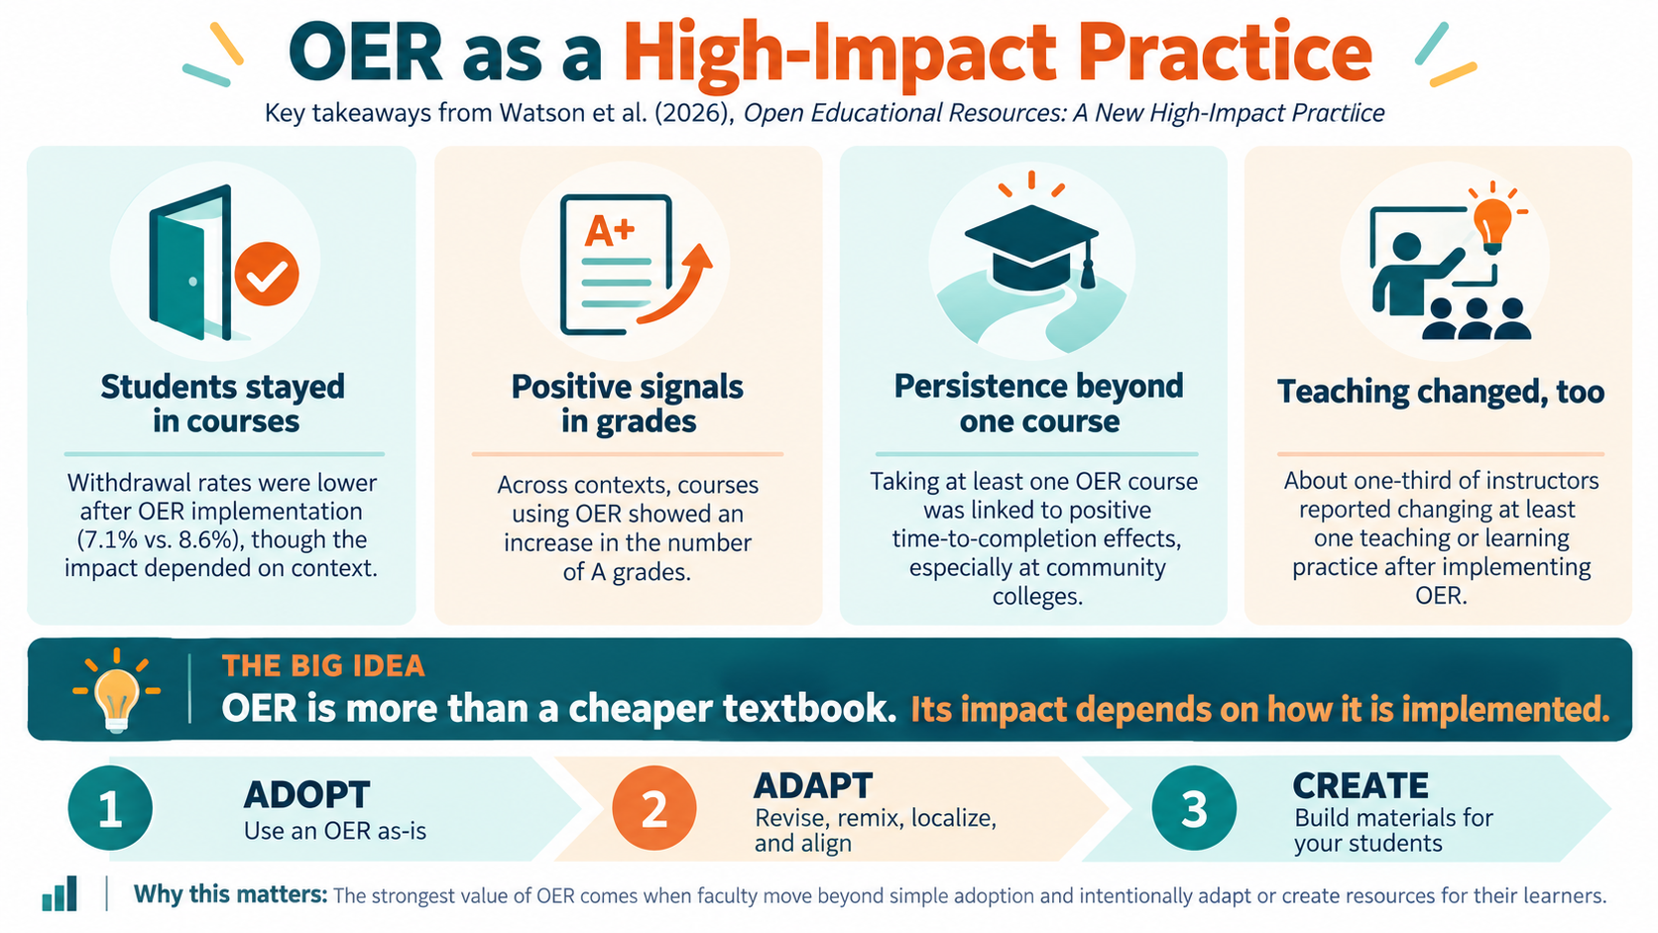

Slide 8
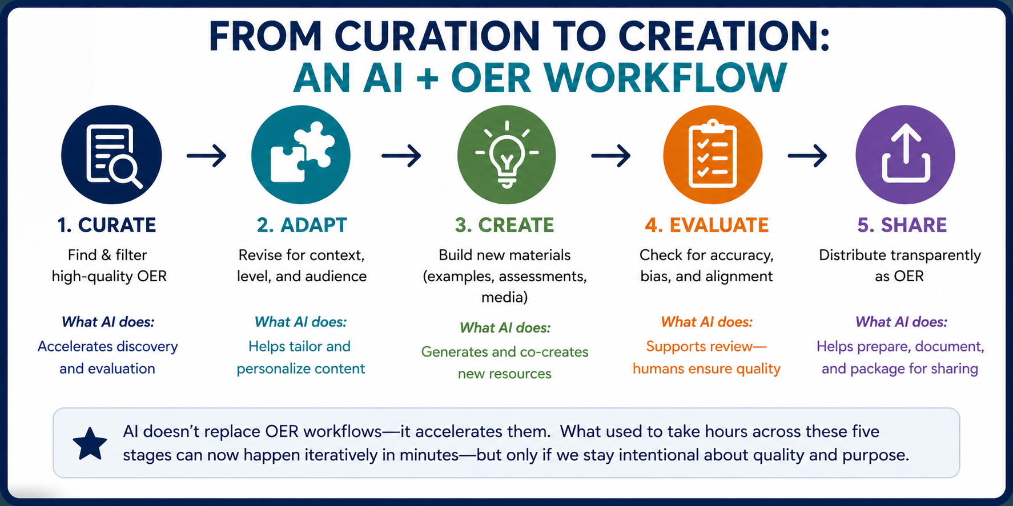

Slide 9
AI Tools
Curation
Perplexity
Adapt
ChatGPT
Create
ChatGPT
Google Scholar Labs
ResearchRabbit
OER Commons
Claude
Gemini
NotebookLM
Claude
Gemini
Copilot
NotebookLM
Evaluate
Human in the loop
Faculty expertise
Accuracy
Bias
Licensing
Generative AI Tools

Slide 10
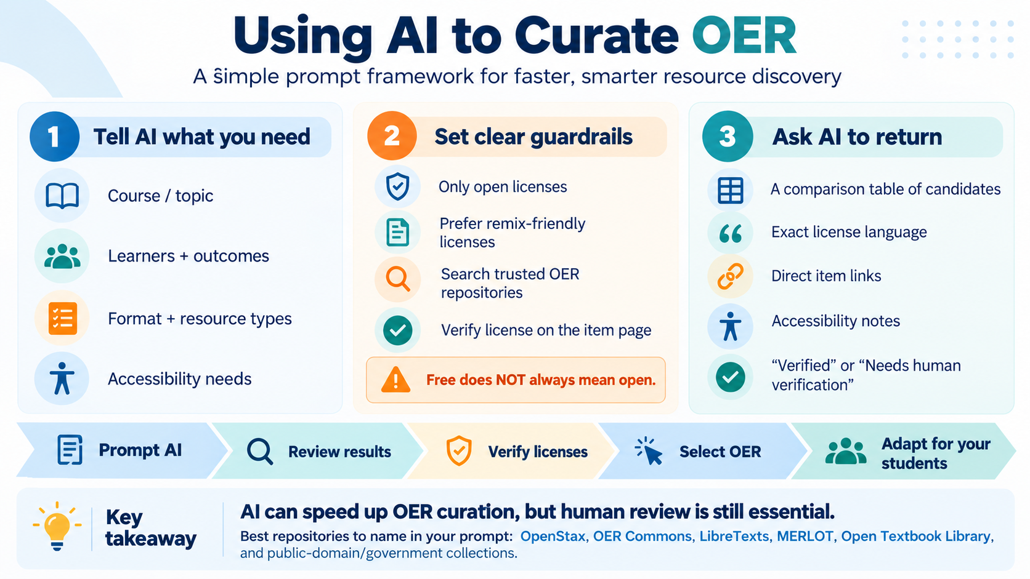

Slide 11
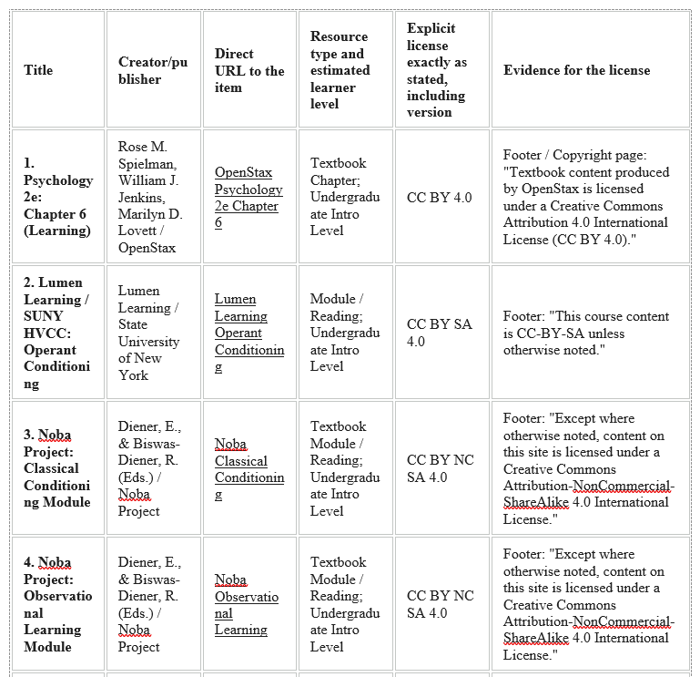
Gemini created list
Act as an OER Librarian
And Instructional Designer

Slide 12
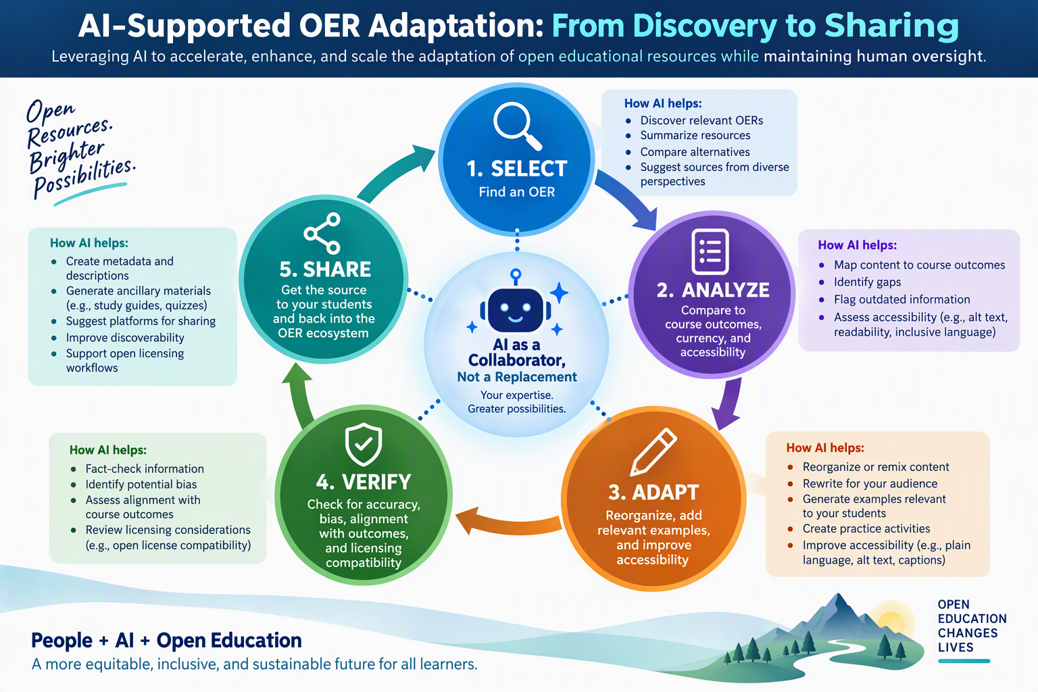

Slide 13
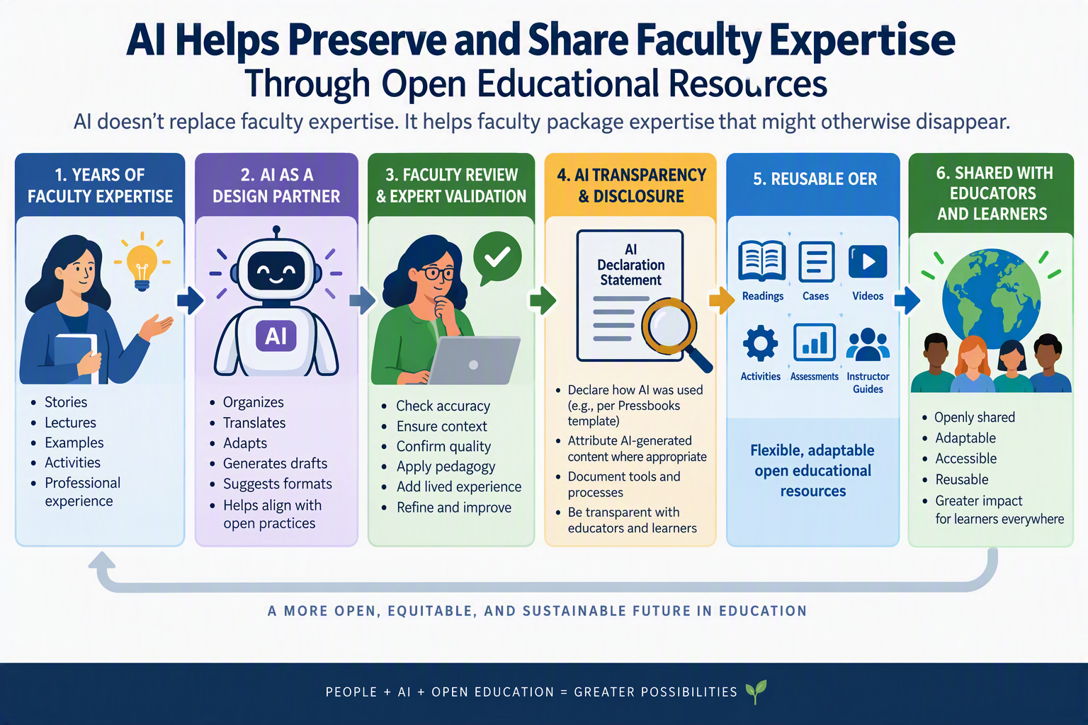

Slide 14
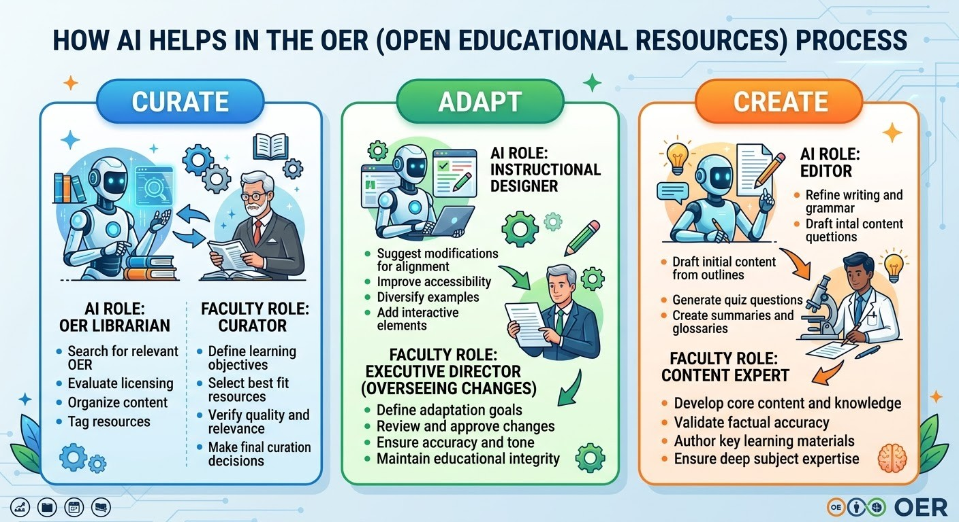

Slide 15

Develop your teaching your way
Thank you!
Email Vincent: vgranito@lorainccc.edu
OneHE: support@onehe.org
www.onehe.org

