Slide 1


Develop your teaching your way
Cultivating Student Voices
James M. Lang
www.onehe.org

Slide 2
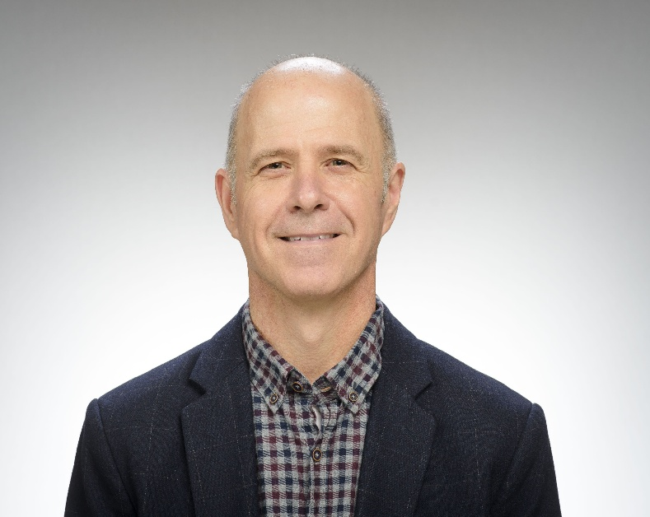
James M. Lang
Professor of Practice
Kaneb Center for Teaching Excellence
University of Notre Dame

Slide 3
Supporting Student Voices
Brainstorming
Writing
Speaking

Slide 4
Premise: “If You Care About It, Do It In Class”
“Whatever you care most about students learning in your course, do it in class.
If you don’t use class time for skills practice, start doing so now.
If you already do, do it more.”
Chronicle of Higher Education
December 2025

Slide 5
Brainstorming Voices

Slide 6
(Not) Listening to One’s Own Voice
You’ve probably heard that AI is great for generating ideas. And brainstorming is certainly one students’ top uses of AI. But we want to urge some caution before you encourage students to start with AI for ideas. It’s sometimes difficult for students to start on a project when they don’t know what direction to go. But once they see a list of ideas from AI, it’s hard for students to see true alternatives, or listen to their own voices.
Norton Guide to AI-Aware Teaching

Slide 7
Flattening Ideas
Navigating the Digital Age: How Technology Shapes Our Social Lives, Learning, and Well-Being
Navigating the Digital Age: A Personal Reflection on Technology
Navigating the Digital Age: A Personal and Peer Perspective on Technology’s Role in Our Lives

Slide 8

How Do We Help Students Ideate?
Classroom Ideation
Freewriting
Small Group Discussions
White Board Brainstorm
Idea Speed Dating

Slide 9
Freewriting
The idea is simply to write for ten minutes (later on, perhaps fifteen or twenty). Don't stop for anything. Go quickly without rushing. Never stop to look back, to cross something out, to wonder how to spell something, to wonder what word or thought to use, or to think about what you are doing. If you can't think of a word or a spelling, just use a squiggle or else write "I can't think what to say, I can't think what to say" as many times as you want; or repeat the last word you wrote over and over again; or anything else.”
Peter Elbow, Writing without Teachers

Slide 10
Writing Voices

Slide 11
Learning or Reflection Journals
Daily or weekly opportunities for students to process their learning or connect it to their lives. These can be done with paper or pencil or in digital formats. Prompts for learning journals might include:
Make a connection between today’s course material and your experiences outside of class or something you’ve learned in another class.
Document an insight you had about our subject matter today.
Note and analyze a comment from a peer in class today.
Identify an area in which you feel less confident in your mastery of the class material.
Make a plan for how you will prepare for you upcoming assessment, especially in light of today’s course material.

Slide 12
Writing from AI Conversations
Develop their initial ideas through in-class brainstorming activities.
Instructor creates AI prompts or a program that helps students develop the ideas further (counterarguments, other possibilities, etc.)
Students come to class and begin writing without the help of their transcript.
When Groff starts something new, she writes it out longhand in large spiral notebooks. After she completes a first draft, she puts it in a bankers box—and never reads it again. Then she’ll start the book over, still in longhand, working from memory. The idea is that this way, only the best, most vital bits survive.
From Mason Curry’s Subtle Maneuvers

Slide 13
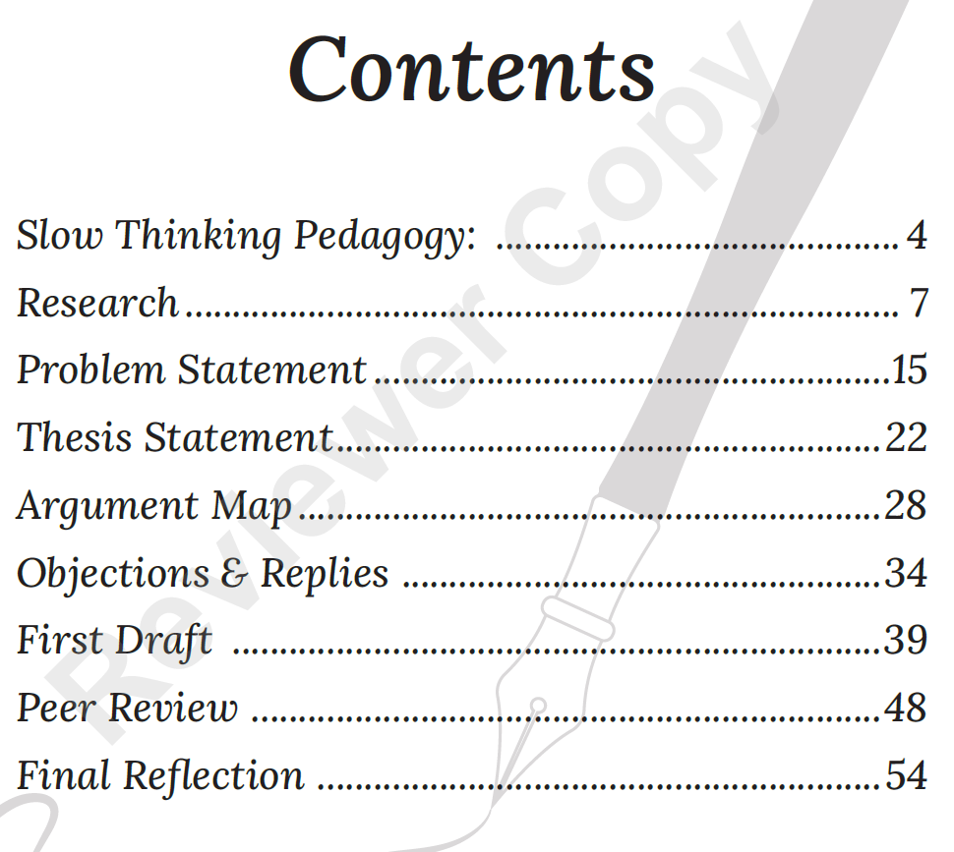
Slow Writing Pedagogy
Lily Abadal, a philosopher from the University of South Florida, asks her students to draft an entire research paper in class over the course of the whole semester. A quarter to a third of her weekly class time is devoted to this process. Drafted

Slide 14
Reluctant Voices

Slide 15

Reluctant Voices
“The first few times I raised my hand and contributed something, I couldn’t hear myself speak at all, so loud was the roaring in my ears. I teared up. I probably turned scarlet. But I participated, and then I participated again. Each time was a little easier. I regained my lost voice.”
Sarah Cavanagh
Chronicle of Higher Education

Slide 16
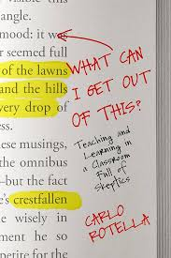
Opening Participation
After you have spoken for the first time in this class, you will have become a student who speaks in class.

Slide 17

Small Classes: Opening Statements
“Everyone will respond to today’s reading/homework/problem with . . .”
A single word
A single sentence
A thirty-second reflection
A one-minute conversation with a neighbor
Notes:
McAvoy Minute Around

Slide 18
Preparing to Speak
Writing Exercises: 150 points. During most class periods, you will complete a writing activity of some kind; these activities are designed to ensure that you are prepared and participating in class. On most days I will ask you to write one paragraph in response to a thought question about the reading. That question will require that you refer to specific elements of the assigned text, and then use those elements to respond to a discussion question that will be addressed in class.

Slide 19
Invitational Participation
Participate. I run a student-centered class which consists largely of writing, discussion, and in-class activities of one kind or another. I want everyone to participate in these activities, including our class discussions. Your unique perspective and ideas are valuable, and might bring to the conversation something nobody else has considered (including me). In addition to calling on volunteers, I will issue regular invitations for individual students to participate in our discussions, and I expect everyone to accept those invitations at least some of the time. If this represents a problem for you for some reason, reach out to me in person or online and we’ll find a way to get you involved so we can hear your good ideas and questions.

Slide 20

Develop your teaching your way
Thank you!
support@onehe.org
www.onehe.org

