Slide 1

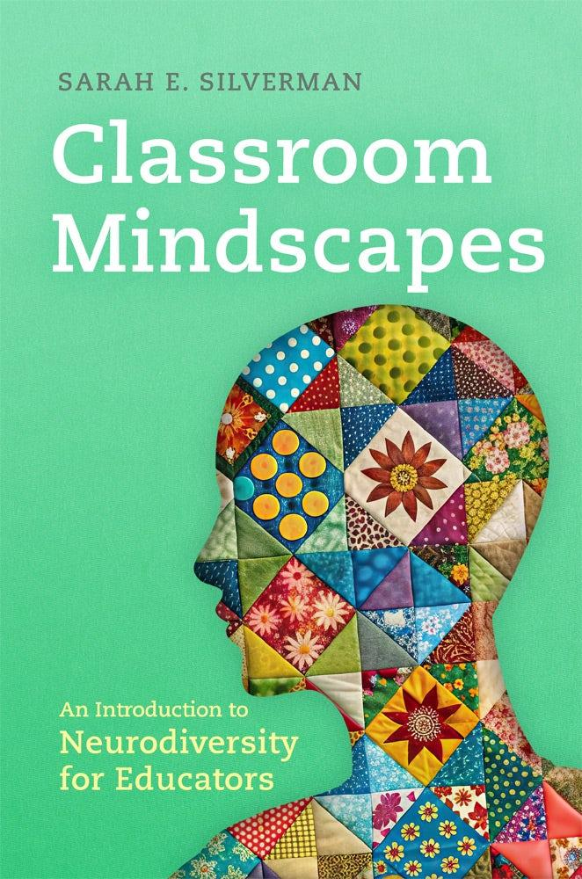

Develop your teaching your way
Classroom Mindscapes: An Introduction to Neurodiversity for Educators
Book Launch
Sarah E. Silverman
www.onehe.org

Slide 2
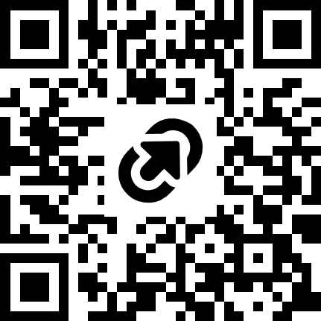
Classroom Mindscapes:
An Introduction to Neurodiversity for Educators
Book launch event with author Sarah Silverman
Buy the book:
tinyurl.com/CM-order
Discount code for 15% off: 18FRIEND20
Open these slides:
tinyurl.com/CM-slides

Slide 3
Welcome and important notes
I am so excited to chat and celebrate the release of this book with you!
This book launch event will last about 30 minutes
  I will share a bit about the book for 15 minutes, and then we will have Q+A
You can participate by
  Using chat to comment, ask questions, or converse with others
  Taking notes, reflect, or engage another way on your own
  Following-up with me after the event

Slide 4
About me
My name is Sarah and I use she/her pronouns
Visual description: White woman with short brown hair and metal glasses frames (today I am wearing a white sweater and a gold necklace)
I teach instructional design and disability studies
I have done faculty development support for about 10 years
My research interests include accessible and feminist pedagogy, Universal Design for Learning (UDL), and the history of the neurodiversity movement

Slide 5

About you
Feel free to use the chat to share you choice of:
Your name
Where you are now
What excites you about neurodiversity?
How is your Fall going if it was a weather report (e.g. stormy, partly cloudy, scattered showers)

Slide 6
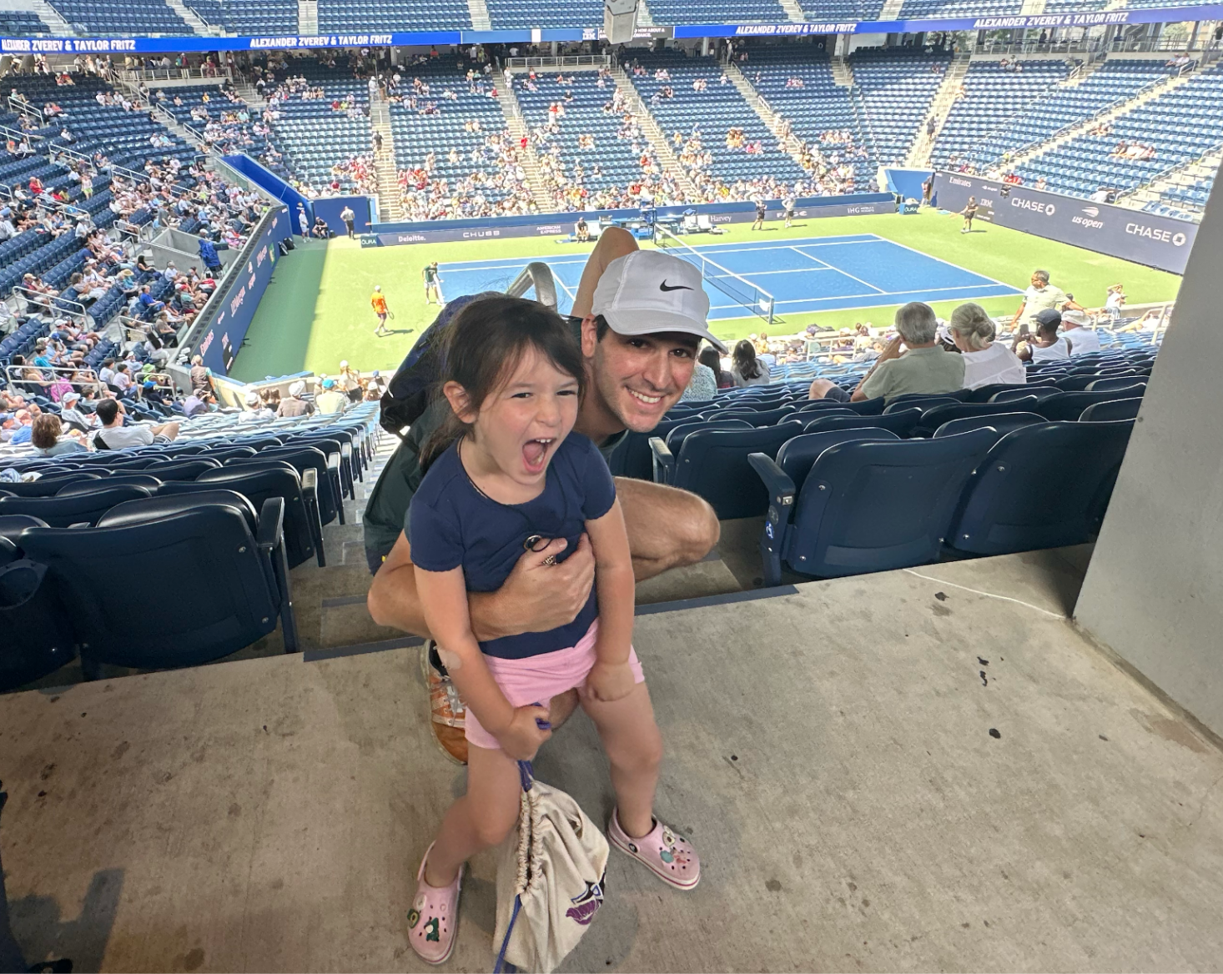
Gratitude
Jim Lang
Derek Krissoff
Andrew Berzanskis (Oklahoma Press)
Workshop/speaking hosts
  Goucher College
  Davidson College
  Wabash College
  The Grading Conference
OneHE
Community of educators, in-person and online
My family (husband, daughter, parents, siblings)

Slide 7
Why this book? Some common questions I hear
“Why does it seem like I am hearing so much more about neurodiversity in higher education in the last few years (last year?)”
“Is neurodiversity just updated/newer terminology for learning disabilities or autism?”
“I have more and more neurodivergent students in my class, but I don’t feel prepared to teach them!”
“My usual plans for group work or requirements for class participation are not working well for neurodivergent students - what should I do?”

Slide 8
Experience and knowledge I draw on
Teaching disability studies
Faculty development related to teaching and instructional design
Guest facilitation on neurodiversity in higher education
Personal experience as a neurodivergent student, staff, and instructor

Slide 9
6 ideas from 6 chapters
Idea 1: Understanding neurodiversity starts with understanding terms
Idea 2: Neurodiversity history shows us how to think about personhood before labels, and how not all differences are pathological
Idea 3: Neurodiversity and disability are partly overlapping but not equivalent concepts
Idea 4: Current educational systems often prioritize normality
Idea 5: Going beyond “supporting neurodivergent students”: Teaching in the neurodiversity paradigm
Idea 6: Recognizing “pressure points” and potential “pressure releases”

Slide 10
Idea 1: Understanding neurodiversity starts with understanding terms
Neurodiversity, neurodivergent, and neurotypical all have evolving meanings and unique histories
These terms provide an alternative, not synonymous, way to discuss cognitive differences to the medical/diagnostic terminology
They originate in the Autistic community that emerged in the 1990s online, where Autistic people first began developing community and group consciousness
Educators who wish to incorporate more discussion of neurodiversity into their teaching and other work can start by understanding how to use these terms in context

Slide 11
Idea 2: Neurodiversity history shows us how to think about personhood before labels, and how not all differences are pathological
Neurodiversity emerged from Autistic self-advocacy communities as a way to understand Autism as not purely a disorder
Key insight: Autistic people have both strengths and challenges
Early activism involved pushing back on crisis narrative and dehumanizing language, pioneering the idea of “acceptance” and “support” vs. “cure”
  In my practice as a teacher, I have learned so much from this shift in perspective from fixing to relating and supporting
The later neurodiversity movement emerged as a coalition of people with different experiences (including Autism, ADHD, learning disabilities etc)
Neurodivergence has always been an umbrella concept

Slide 12
Idea 3: Neurodiversity and disability are partly overlapping but not equivalent concepts
Neurodiversity is an idea about cognitive variation, and neurodivergence is a description of how some people’s cognitive traits do not align with contextual norms
Disability is a larger category, which also has legal/policy implications in an educational context
Many neurodivergent students and staff/faculty could be viewed as having a disability, though some may not disclose or document
Details on why there may be increasing numbers of neurodivergent students, which models of disability align with a neurodiversity perspective, and some persona studies that help us understand disclosure considerations in higher ed

Slide 13
Idea 4: Current educational systems often prioritize normality - What are some responses?
Using Jay Dolmage’s metaphor from Academic Ableism, we find many forms of “steep steps” for neurodivergent students in higher education
Admissions procedures
Assessment and grading
Graduation requirement
Social expectations
Existing responses may fall into the categories of “retrofits” and “universal design” with potential benefits associated with each

Slide 14
Idea 5: Going beyond “supporting neurodivergent students”
“Teaching in the neurodiversity paradigm” is my concept for how we can respond to neurodiversity in our own teaching environments
It is a practice of navigation and negotiation, rather than application of rules
We can recognize the positives of cognitive variation
We can exhibit humility about our own thought and communication
We can embrace “tolerance for error”
We can expect and tactfully navigate access friction, or conflicts of access needs

Slide 15
Nick Walker on “Neurocosmopolitanism”
“What might classroom education look like at various levels from preschool through grad school, in the context of a neurocosmopolitan approach to education in which it’s built into the curriculum that every person in the class, teachers and students alike, works at learning to comprehend and accommodate the neurocognitive styles and communication needs of every other person in the class as best they can? What if both the education of youth and adults, and the training of educators, included the explicit understanding that no neurocognitive style is more ‘correct’ or ‘normal’ than any other, and that the work of mutual accommodation is both an essential part of a proper education and an essential preparation for being a participating citizen in a civilized society?”
-Nick Walker, Neuroqueer Heresies

Slide 16
Idea 6: Recognizing “pressure points” and potential “pressure releases”
Margaret Price’s concept of kairotic space forms the foundation of this chapter
  These are the spaces in academia which are high stakes, rapidly unfolding, and highly social
  They can be challenging for neurodivergent students to navigate, and they can be challenging to design for neurodiverse groups
  Pressure can be released by surfacing access friction, providing a “ramp” up to higher stakes activities, and clarifying norms and social expectations with minimal judgement
Labs
Collaborative activities
Simulations
Class discussion and small seminars

Slide 17
In Summary: Why read this book?
Learn the histories and meanings of key terms related to neurodiversity
Understand the main contributions of the neurodiversity movement and how they can inform teaching
Understand the intersection of disability and neurodiversity, including why some neurodivergent students and staff use accommodations and others don’t
Consider what a teaching and learning environment could look like when we recognize that there is not a single “right” way to think
Learn from my experiences as a teacher, faculty developer, and neurodivergent person in higher ed

Slide 18
Wrap up, and useful links
Buy the book:
tinyurl.com/CM-order
Discount code for 15% off: 18FRIEND20
Email me: sarahsilverman24@gmail.com
Connect on LinkedIn
My website (for speaking and workshops)
My newsletter: beyondthescope.substack.com

Slide 19
Your questions
Any questions about the content, or how this book might be different from other great books about neurodiversity?
Questions about where the conversation about neurodiversity in higher ed might be going in the next few years?
Anything else?

Slide 20


Develop your teaching your way
Thank you!
support@onehe.org
www.onehe.org

