Slide 1

“Use Tomorrow” Strategies for Supporting Neurodivergent Students
Jennifer Pusateri

Slide 2
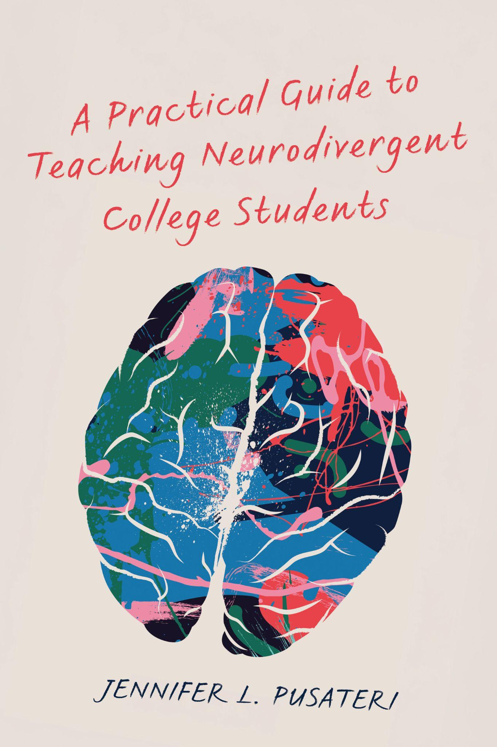
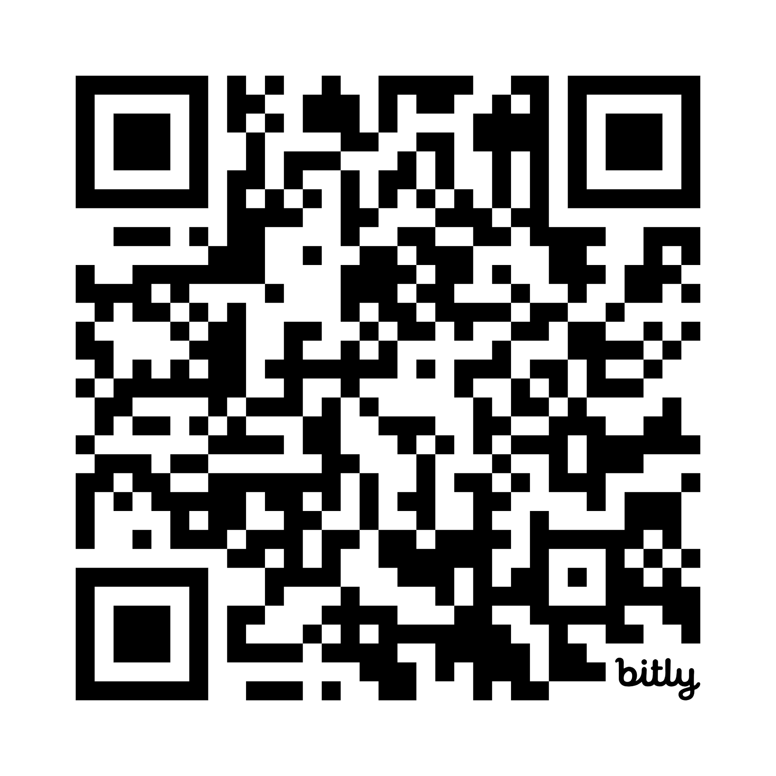
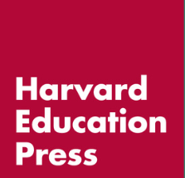
Available Now!
A Practical Guide to Teaching Neurodivergent College Students
by Jennifer Pusateri
Save 20% with sales code HCPR26
at bit.ly/TeachingNDCS

Slide 3
Please note:
The stories, opinions, and content in this presentation are my own, and do not necessarily reflect those of the University of Kentucky.

Slide 4
Why Write This Book?

Slide 5
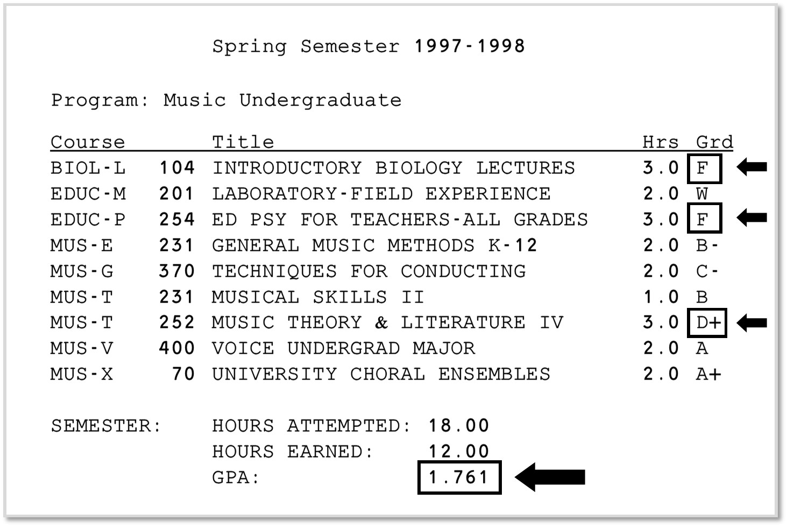
As an undergrad, I was not a “good student”…

Slide 6
How the Book is Organized
Part 1
Understanding Neurodivergence
Part 2
Planning & Designing ND-Friendly Teaching
Part 3
Strategies to Support Neurodivergent Students

Slide 7
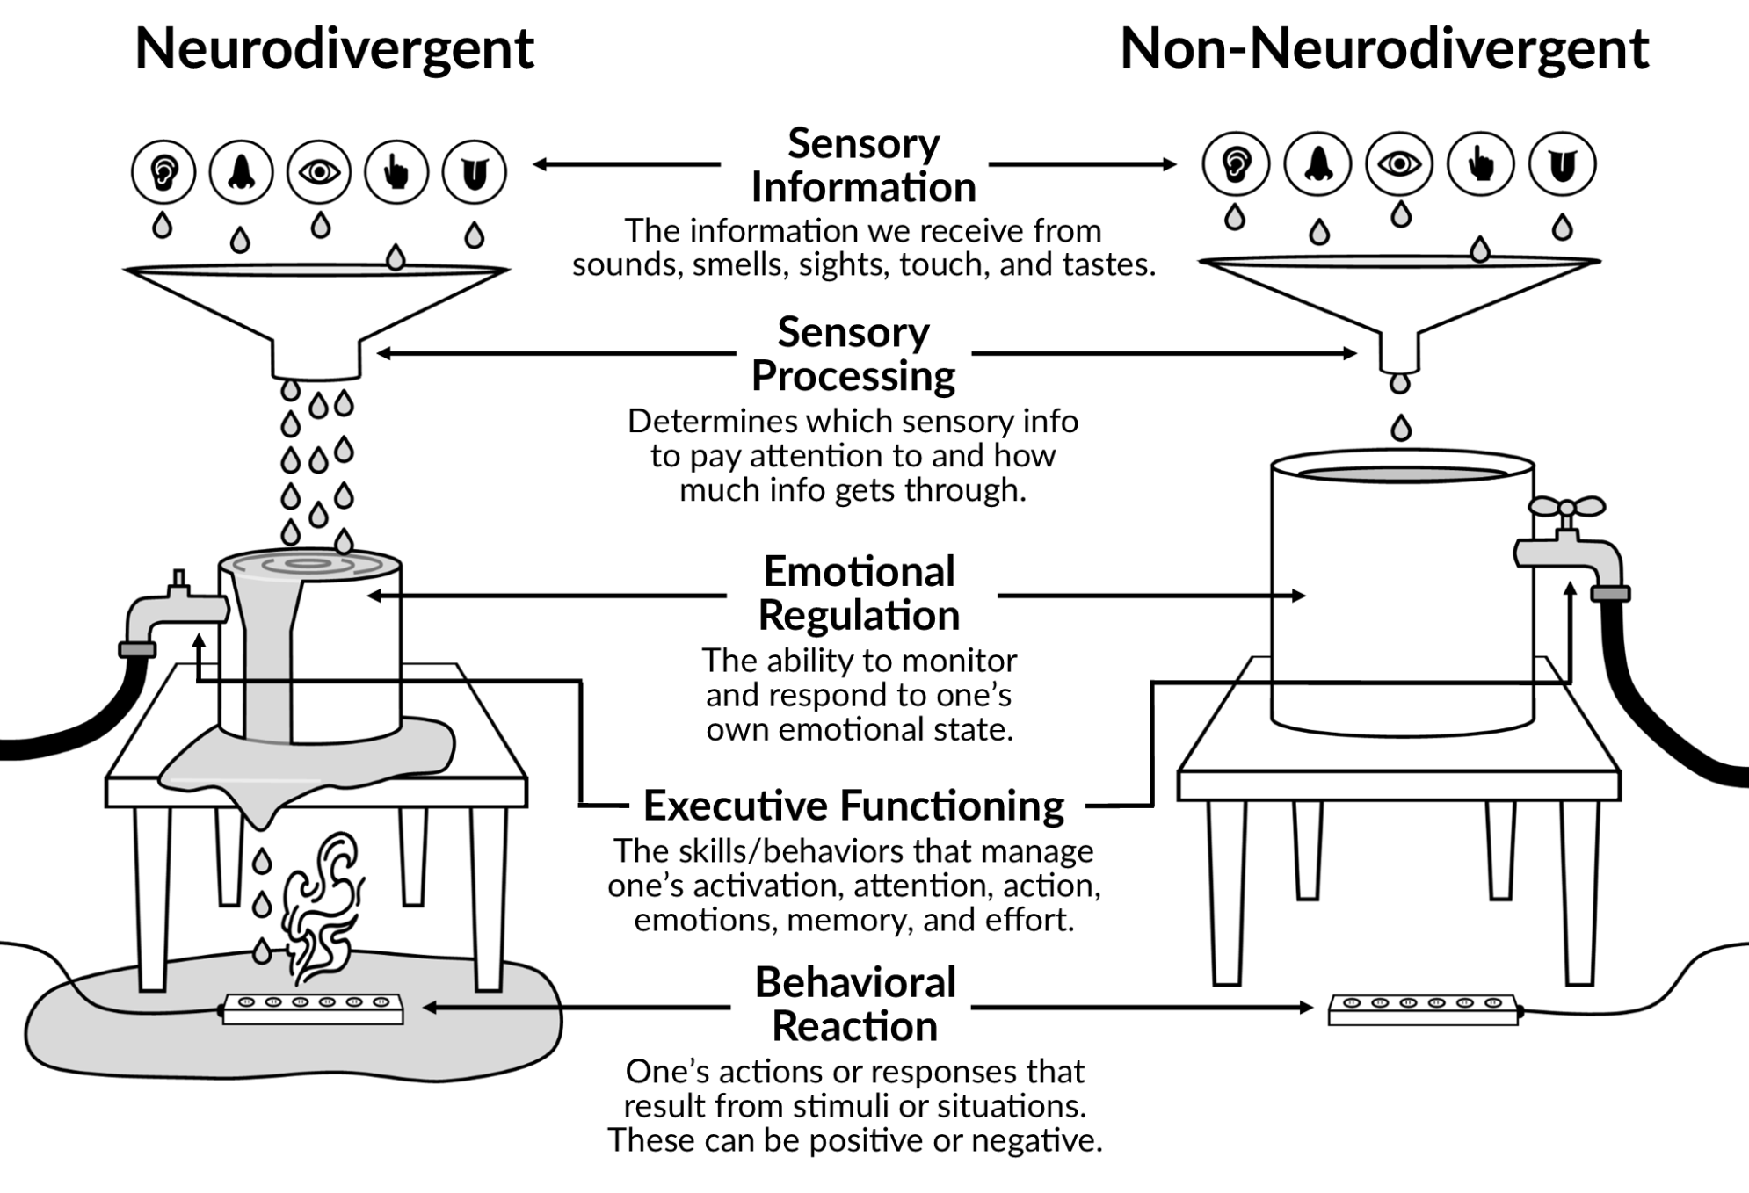
Sensory & Emotions
Image by J. Pusateri based on Brindle et al., 2015; Fernandez-Prieto et al., 2021; Rodriguez & Kross, 2023

Slide 8
PART 1:
Understanding Neurodivergence

Slide 9
Neuro-vocabulary

Slide 10
Neuro-vocabulary 1
Neurodiversity
An idea or concept
Neurotypical
A social construct: “the norm”
Neurodivergent
A social construct:
“the other”

Slide 11
The Neurodivergent Umbrella

Slide 12
Neurodivergent Students (Doyle, 2020)
Learning Disabilities
Behavioral Conditions
Mental Health Conditions
Neurological Conditions
Relates to…
Relates to…
Relates to…
Relates to…
Educational Skills
Behavioral Skills
Mental Health
Health Conditions
Dyslexia
Dysgraphia
Dyspraxia
Dyscalculia
ADHD
Autism
Tourette Syndrome
OCD
Depression
Anxiety
Trauma
Brain Injury
Seizures
Sensory Processing

Slide 13
Prevalence of Neurodivergence

Slide 14
Prevalence of Neurodivergence in Higher Education
Category | Condition(s) | U.S.
Learning Disabilities | Dyslexia, Dyspraxia, Dyscalculia, Dysgraphia | 7%
blank | ADHD | 18%
Behavioral Conditions | Autism | 5%
blank | Tourette Syndrome | <1%
blank | OCD | 8%
Mental Health Conditions | Depression | 28%
blank | Anxiety | 37%
blank | Trauma/PTSD | 10%
Neurological Conditions | Brain Injury | 2%
Data from 2025 Fall National College Health Assessment (NCHA) III (ACHA, 2026)

Slide 15
Neurodivergent Strengths

Slide 16
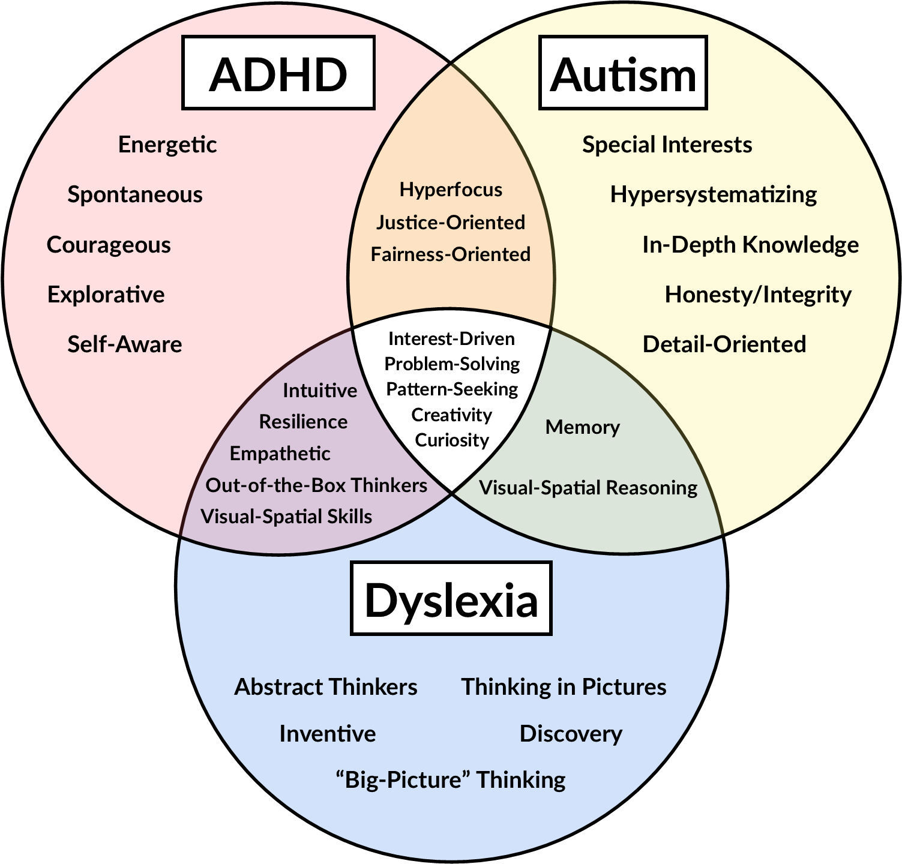
Overlapping Neurodivergent Strengths
Interest-driven
Problem-solving
Pattern-seeking
Creativity
Curiosity
© 2025-Image Designed by J. Pusateri
Adapted from ADDitude Editors, 2023; Cherewick & Matergia, 2024; Hotez et al., 2022; Kannangara et al., 2018; Nordby et al., 2023; Petrova. n.d.; Taylor & Vestergaard, 2022; Wallbank, 2023

Slide 17
Challenges Encountered by NDS

Slide 18
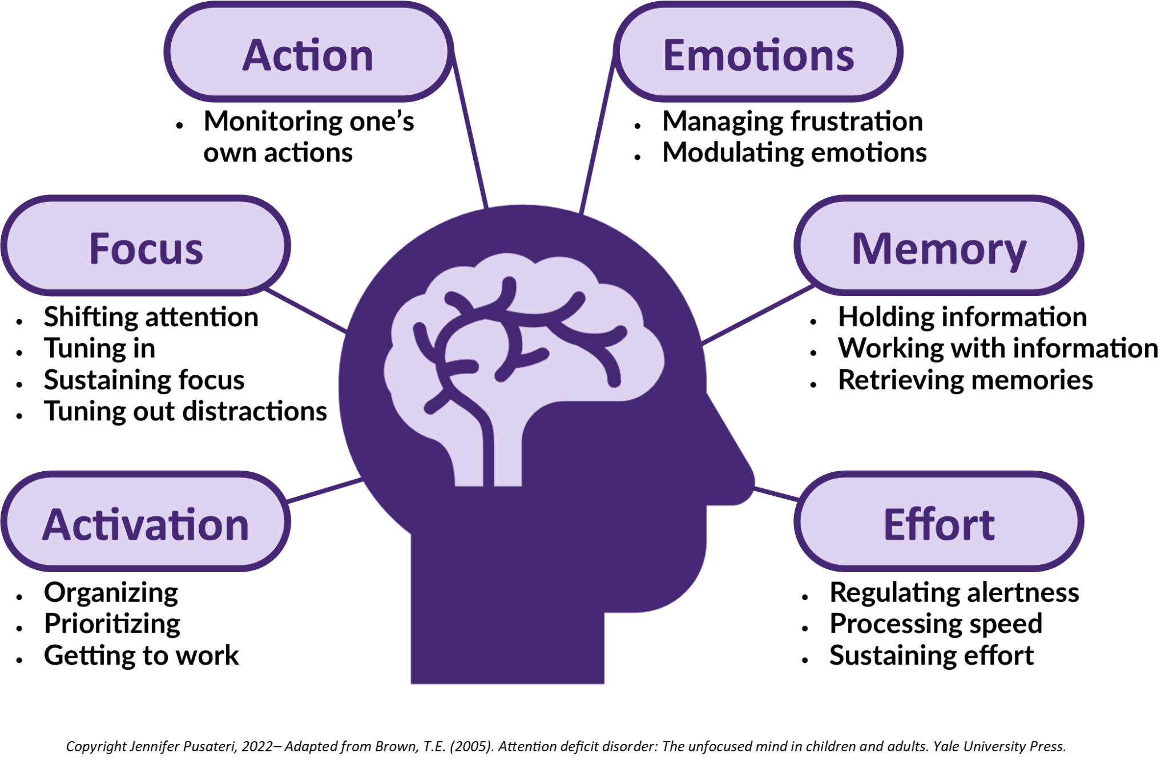
Executive Functioning
(Brown, 2005)
Notes:
Brown, T.E. (2005). Attention deficit disorder: The unfocused mind in children and adults. Yale University Press.

Slide 19
Additional Challenges
Unclear Expectations
Executive Functions
Social Interaction
Sensory Regulation

Slide 20
ND Doc. Students Can Encounter Difficulties with:
Challenge Categories:
Focus, Attention, & Motivation
Organization & Structure
Unclear Expectations & Social Interaction
Time-Management & Prioritization
Sensory & Emotional Regulation
Working Memory & Processing

Slide 21
PART 2:
Designing ND-Friendly Instruction with UDL

Slide 22
What is Universal Design for Learning (UDL)?
“What is necessary for some is good for all”
UDL is an evidence-based planning framework that removes unintentional learning barriers through proactive and intentional design.

Slide 23
Why UDL?
In preparation for this book I read tons of articles that provided suggestions for instructors on how to support neurodivergent college students in their courses.
Nearly every article suggested Universal Design for Learning (UDL) as an ideal framework for supporting neurodivergent students.

Slide 24
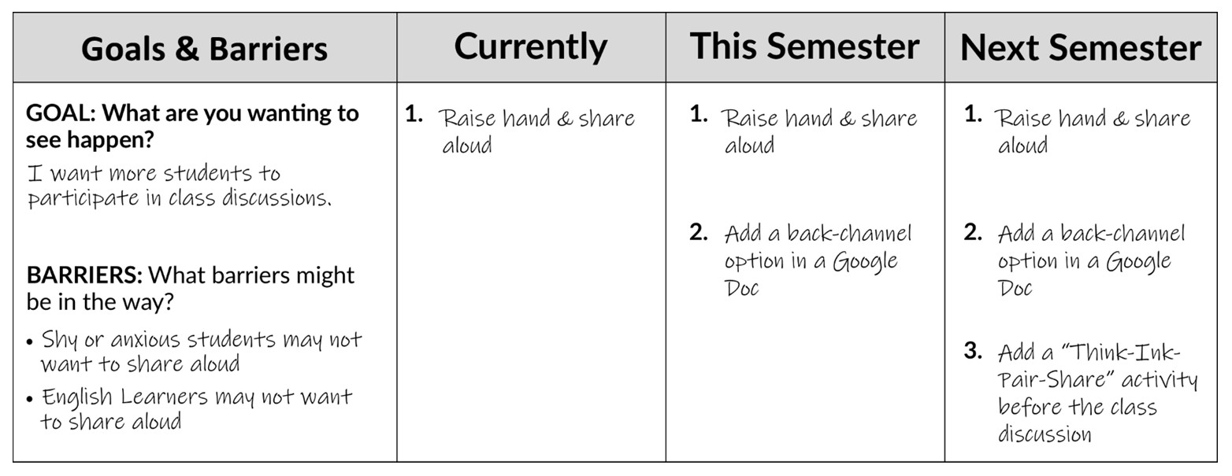
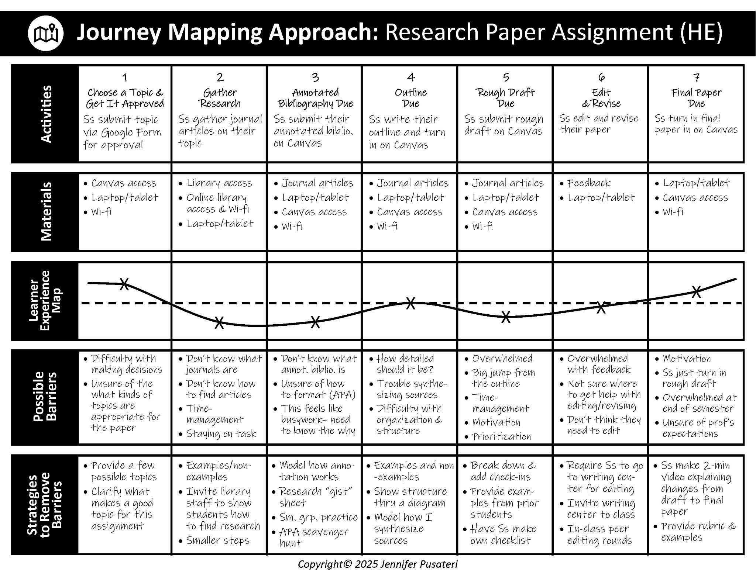
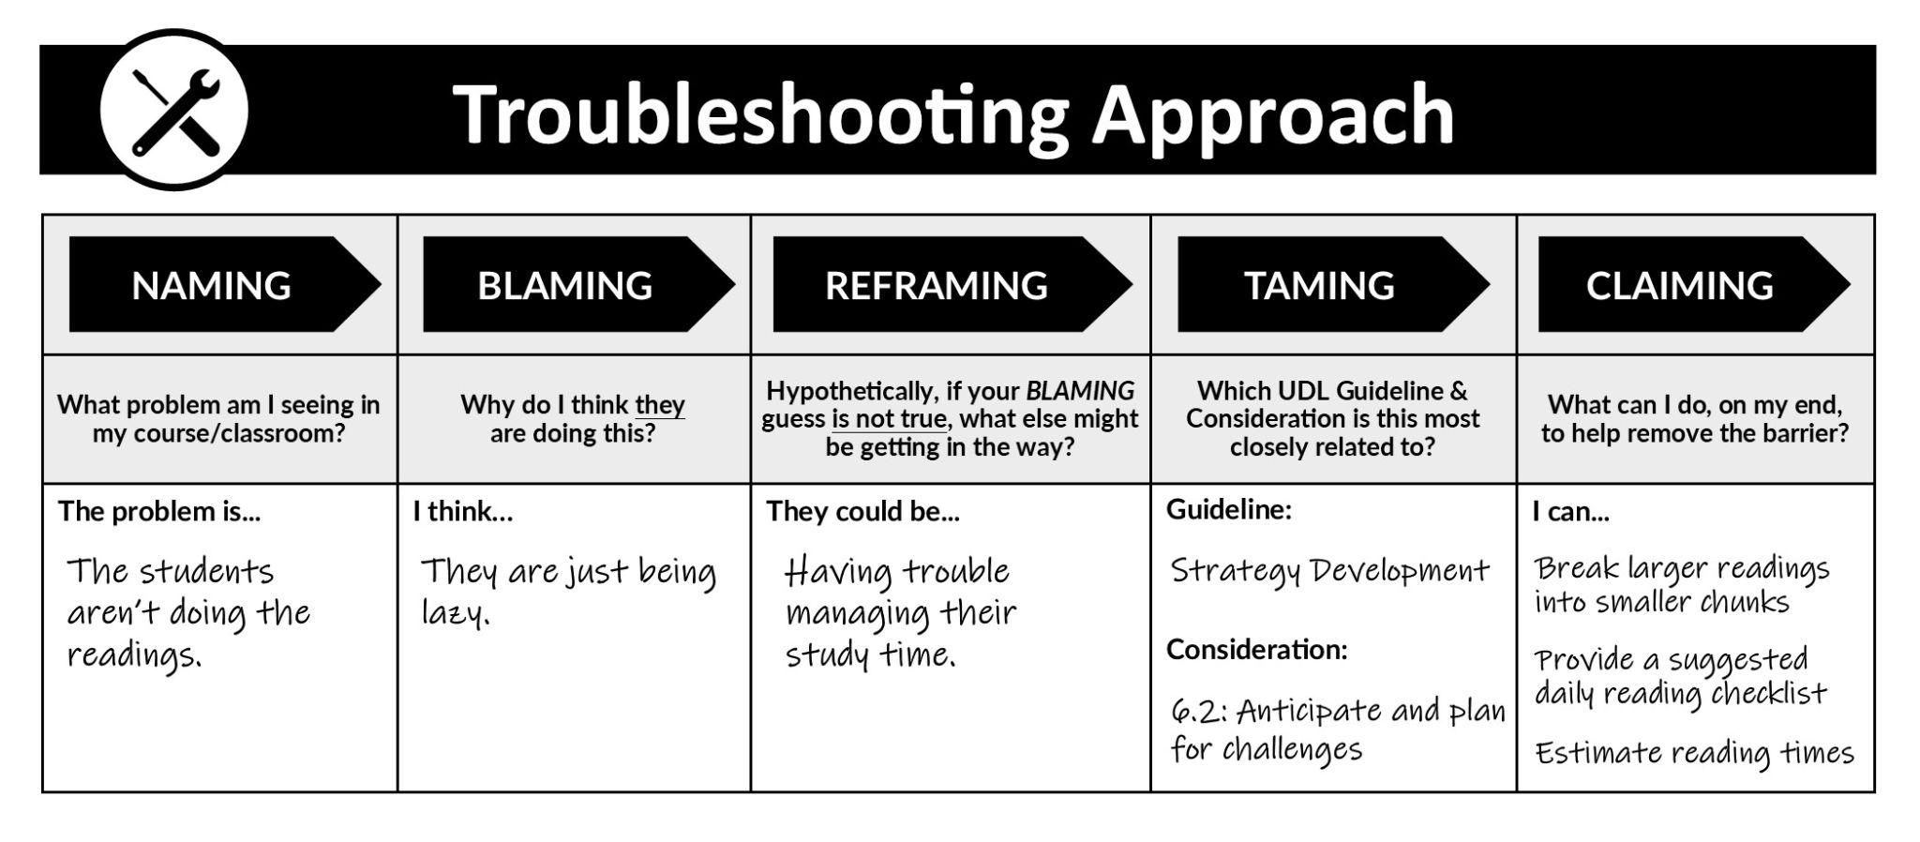
3 UDL Planning Approaches (with templates!)
Plus-One Approach
Journey Mapping Approach

Slide 25
PART 3:
Strategies for Supporting NDS
Notes:
11:35

Slide 26
Proactively Remove Barriers for Neurodivergent Students
Focus, Attention, & Motivation
Organization & Structure
Unclear Expectations & Social Interactions
Time-Management & Prioritization
Sensory & Emotional Regulation
Working Memory & Processing

Slide 27
1. Focus, Attention, & Motivation
Notes:
11:35

Slide 28
Passive vs. Active

Slide 29
Active vs. Passive
= Passive
= Active
BEFORE
Introduction
Topic 1
Topic 2
Topic 3
Q & A
2
12
14
12
5
45 minutes
45 minutes
AFTER
Introduction
Reflection
Discussion
Groups
Final
Thoughts
Topic 1
Share Out
Topic 2
Topic 3
Q & A
5
5
1
5
5
10
7
2
5

Slide 30
2. Organization
& Structure
Notes:
11:35

Slide 31
Intentional Slide Structure

Slide 32
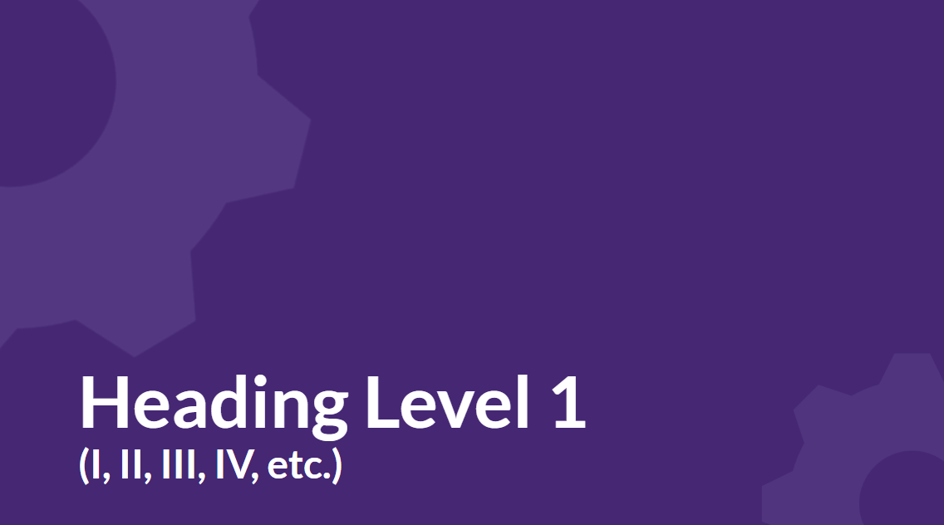
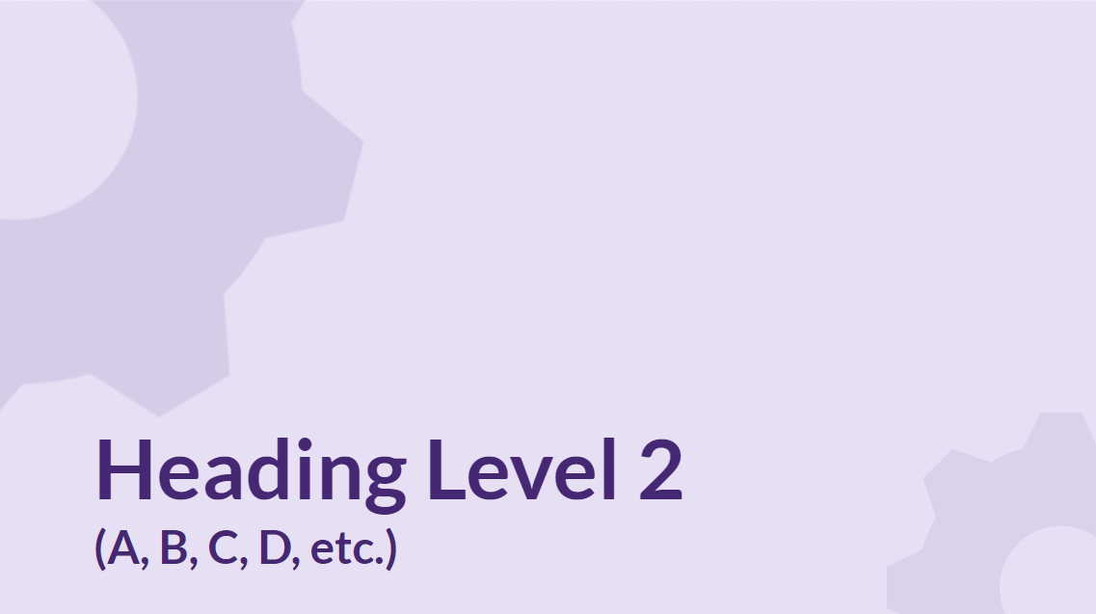
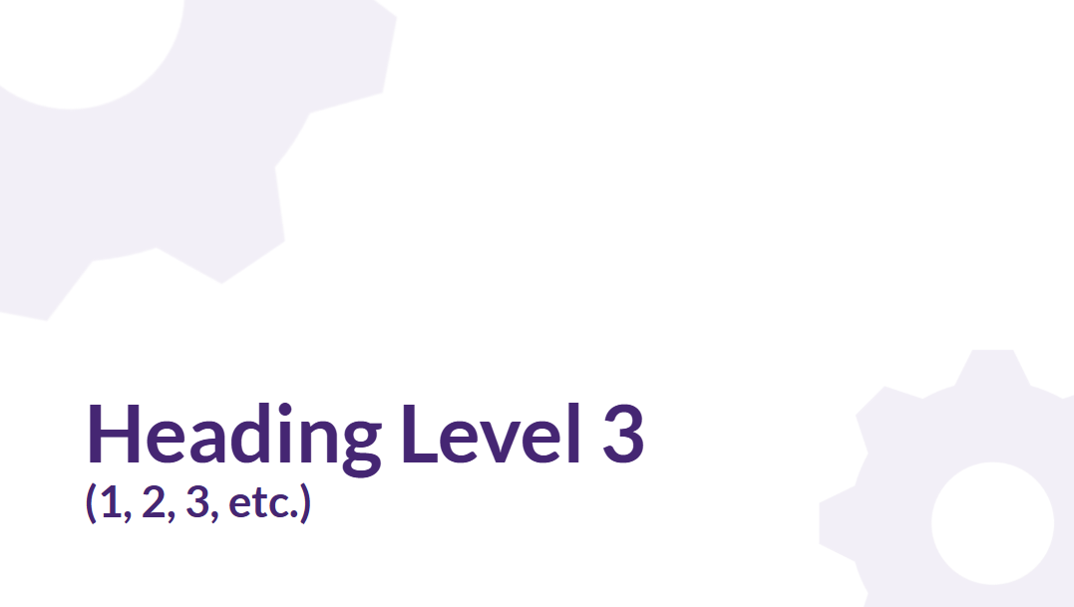
Intentional Slide Structure 2

Slide 33
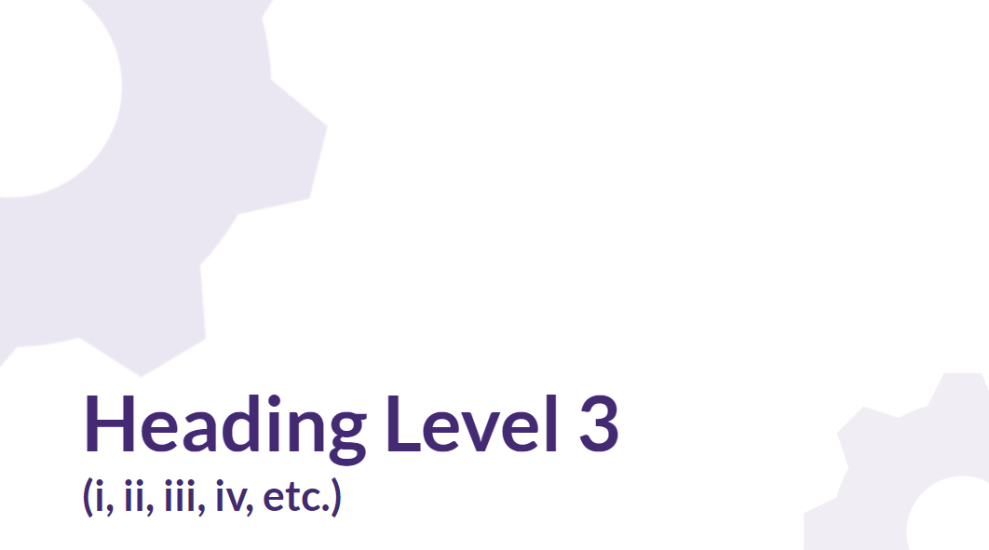
Organize Your Slides Like a Visual Outline
Heading Level 1
Major Topic
  Sub Topic
  Sub Topic
Major Topic
  Sub Topic
    Sub-sub Topic
    Sub-sub Topic
  Sub Topic
Major Topic
Heading Level 2
Heading Level 3

Slide 34
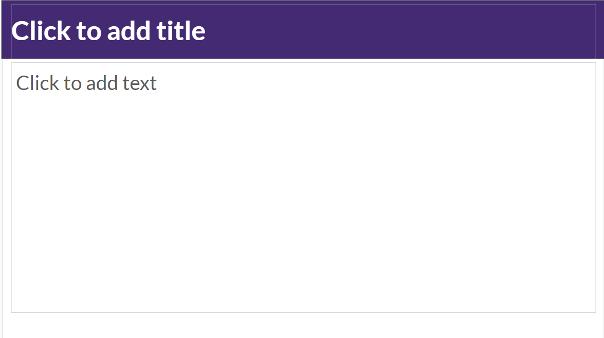
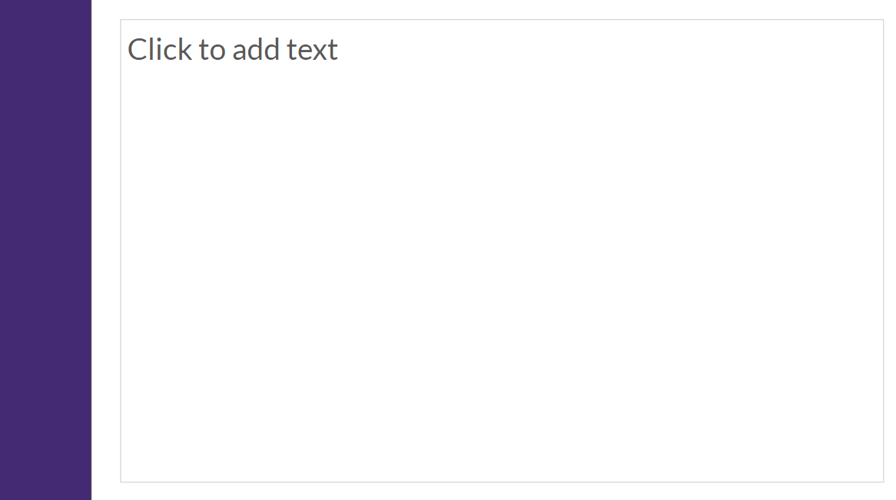
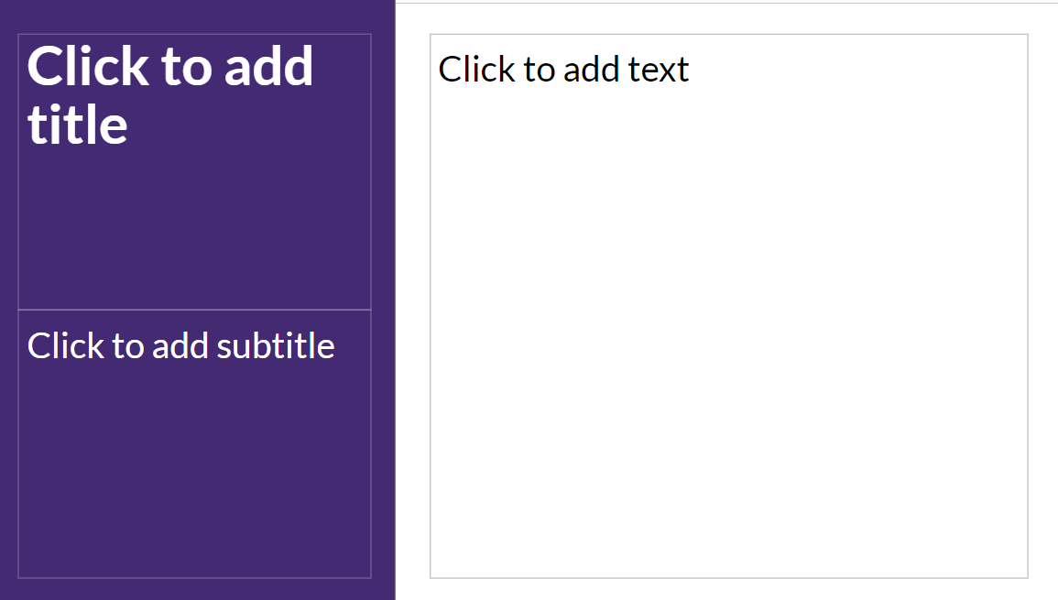
Clear Difference Between “Header” and “Content” Slides
Header Slides
Content Slides

Slide 35
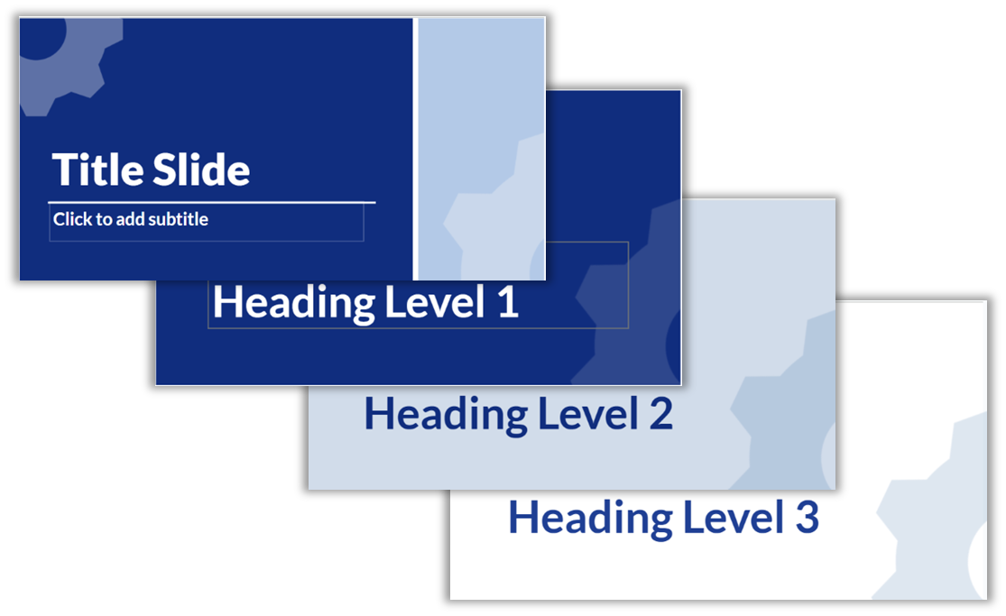
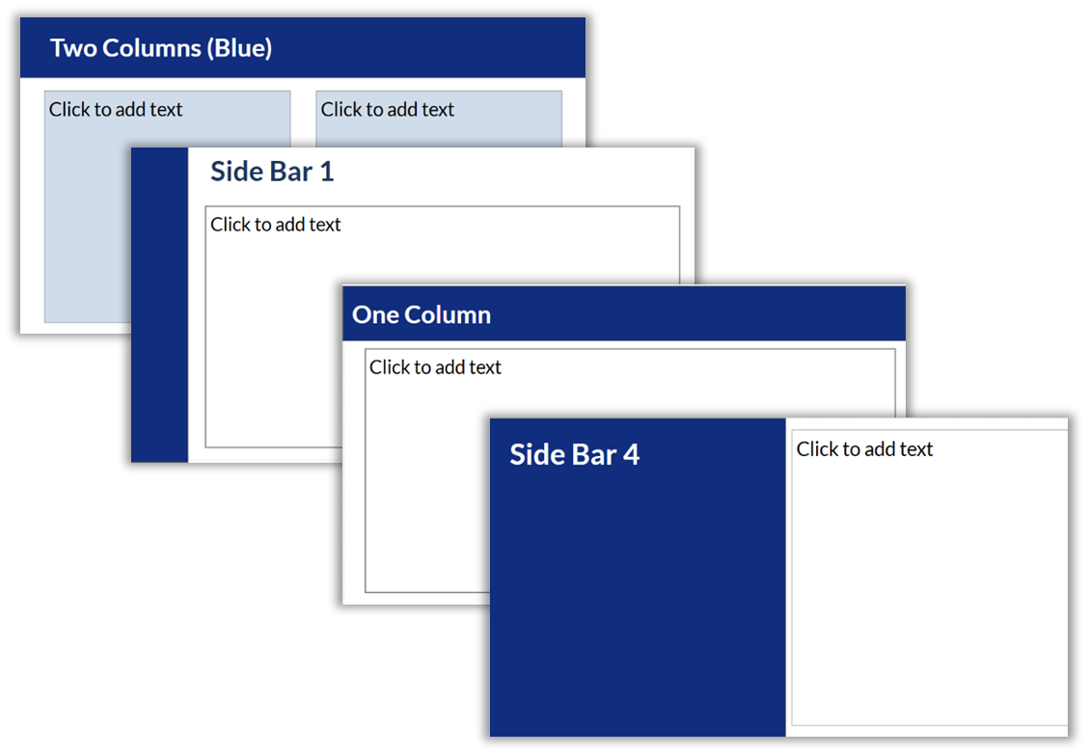
Intentional Slide Structure Template
Link to Google Slides Intentional Slide Structure Template
(you will be asked to make a copy)

Slide 36
3. Unclear Expectations
& Social Interactions
Notes:
11:45

Slide 37
Explicitly State Behavioral
Expectations

Slide 38
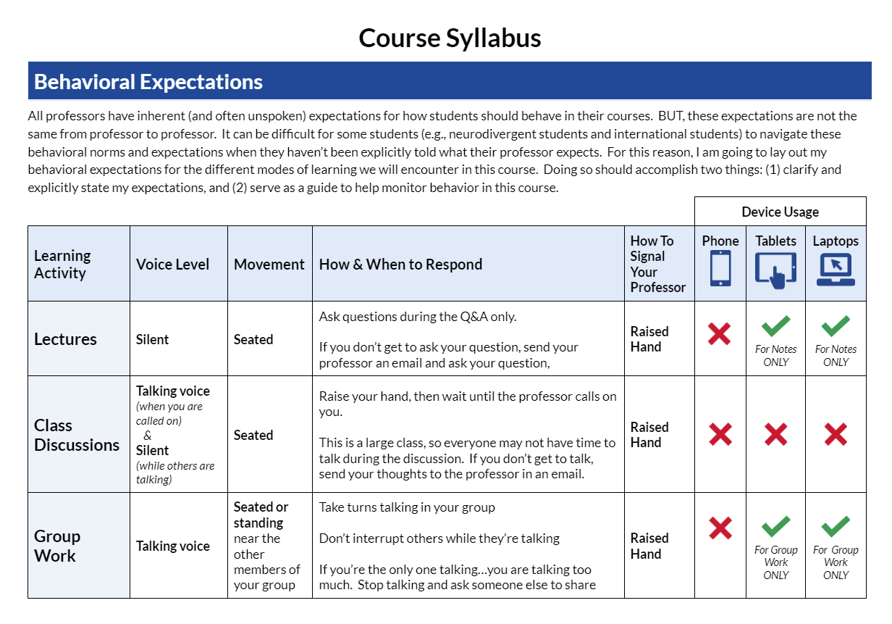
Behavioral Expectations in the Syllabus
Course Syllabus Behavioral Expectations

Slide 39
4. Time-Management
& Prioritization
Notes:
11:50

Slide 40
The Now vs.
NOT Now Principle

Slide 41
Now vs. NOT Now
Coined by Dr. Ned Hallowell, a neurodivergent psychiatrist and world-renowned authority on ADHD:
“In the world of ADHD, there are only two times:
there is NOW, and then there is NOT NOW”
Attention goes to whatever is imminent.
Leads to procrastination & last-minute scrambling
Makes long-term projects very difficult to manage

Slide 42
5. Emotional & Sensory Regulation
Notes:
11:50

Slide 43
Sensory & Emotions
Image by J. Pusateri based on Brindle et al., 2015; Fernandez-Prieto et al., 2021; Rodriguez & Kross, 2023

Slide 44
Normalize Fidgeting/Stimming

Slide 45
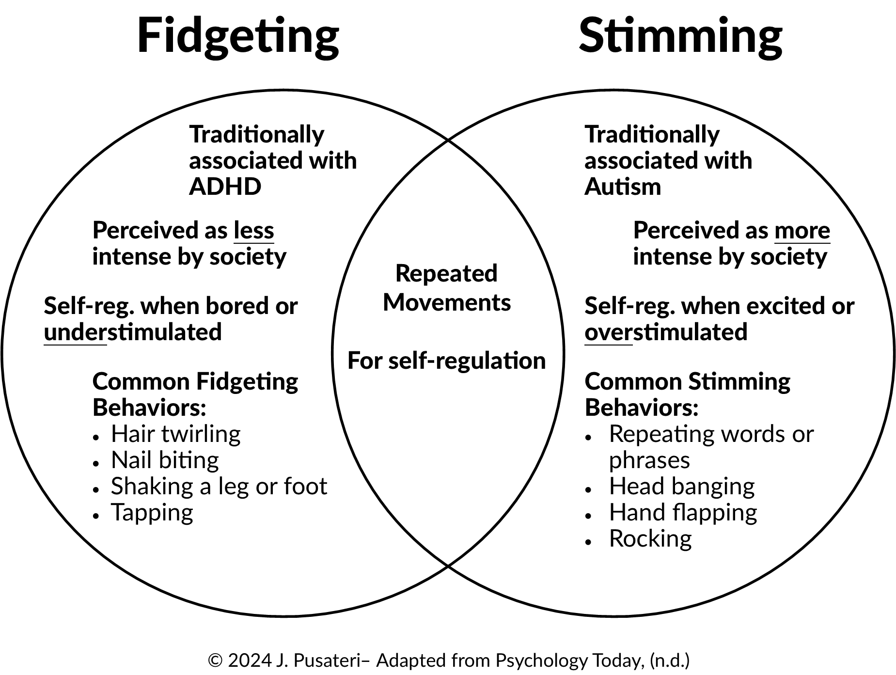
Fidgeting vs. Stimming
© Image created by 2024 J. Pusateri- Adapted from Psychology Today (n.d.)

Slide 46
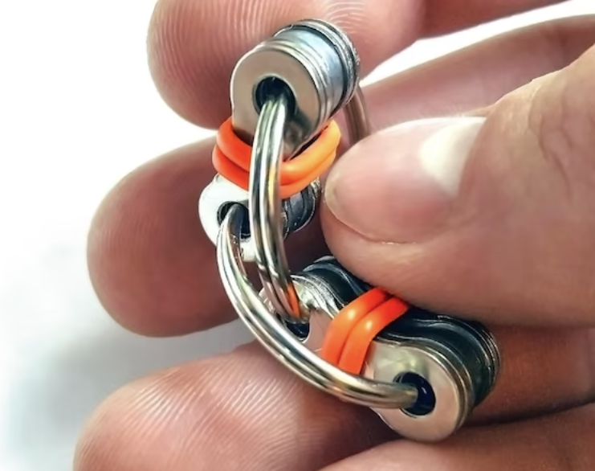


Allow Students to Self-Regulate Through Stimming
Fidget toys
Crocheting or knitting
Drawing
Silent tapping
Standing & swaying
Foot shaking

Slide 47
6. Working Memory
& Processing
Notes:
11:55

Slide 48
Don’t Just Tell Them:
Auditory Processing

Slide 49
What is auditory processing?
“Auditory processing is what the brain does with what the ears hear.”
— Jack Katz, Ph.D., CCC-A/SLP

Slide 50
Auditory Processing & Neurodivergence
(Luo, 2020)
Auditory processing difficulties can look like:
Difficulty understanding spoken language in noisy backgrounds
Difficulty understanding and following rapid speech
Difficulty understanding speech in different accents or dialects
Often asking “what?” or “huh?” when spoken to, or asking for the speaker to repeat themselves
Trouble paying attention and being easily distracted
Needing captions to watch TV/videos

Slide 51
How You Can Help
Write it down
Provide directions in written form
Send a follow-up email
If you are meeting on Zoom:
  Offer to record the meeting or send students a transcript
  Turn the captions on

Slide 52
Available Now!
A Practical Guide to Teaching Neurodivergent College Students
by Jennifer Pusateri
Save 20% with sales code HCPR26
at bit.ly/TeachingNDCS

Slide 53
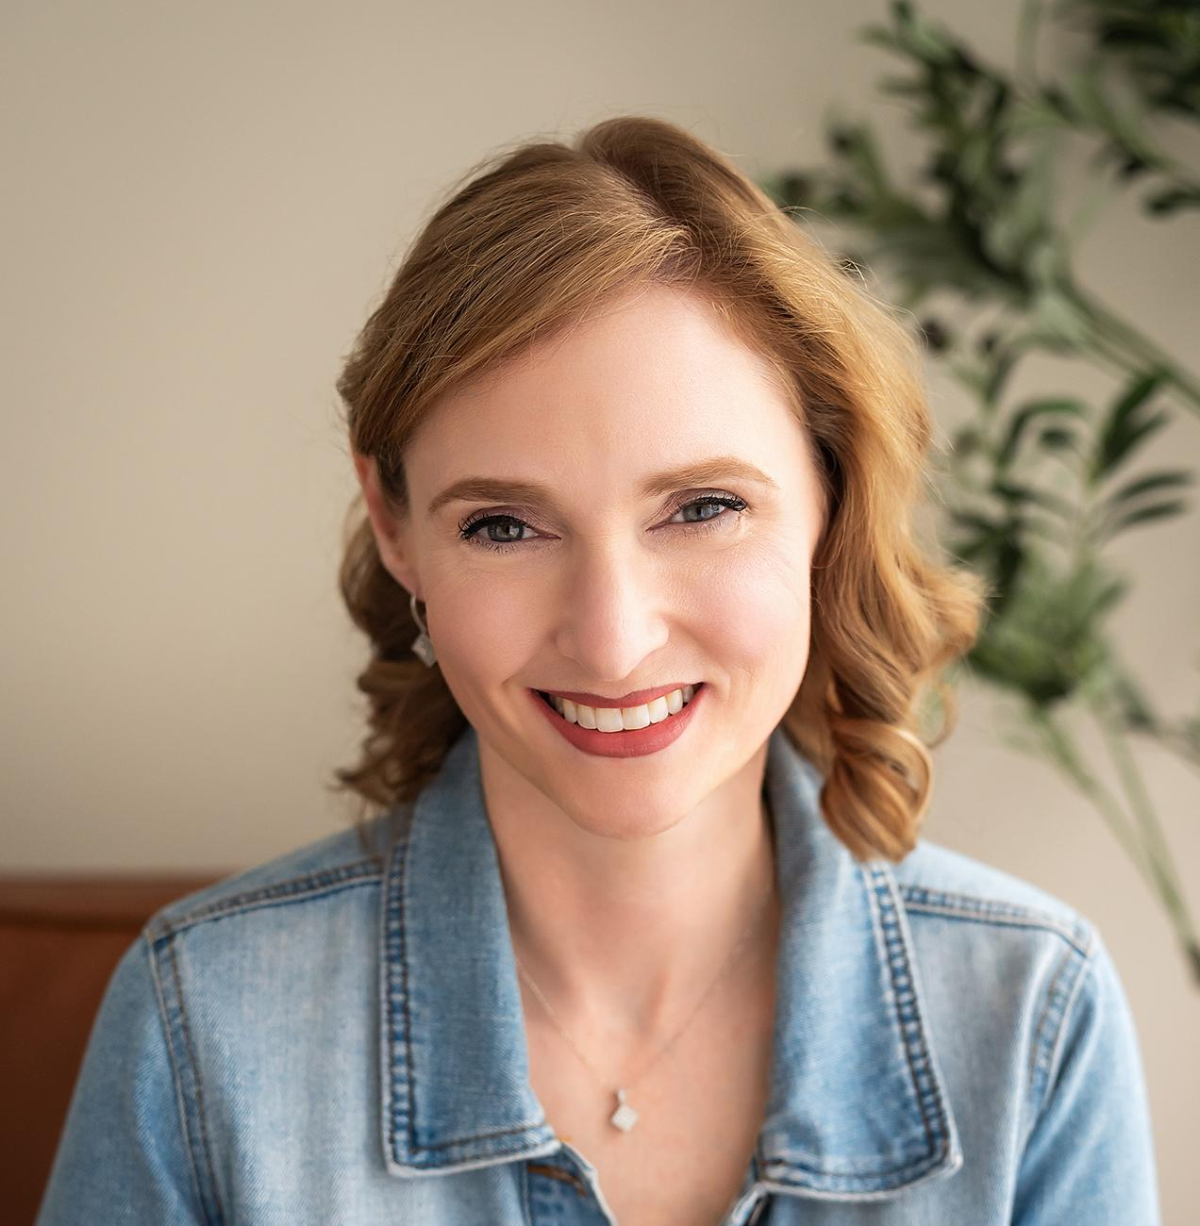
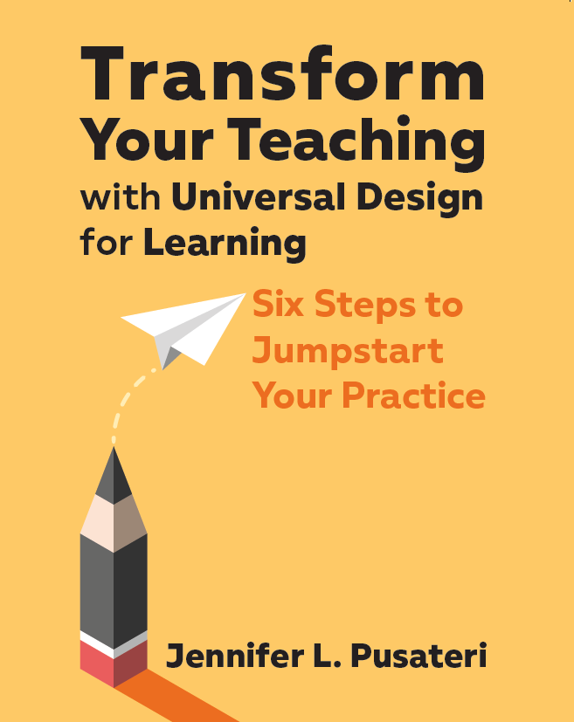
Jennifer Pusateri, PhD
University of Kentucky, CELT
Senior Universal Design Consultant
Kentucky Department of Education,
UDL and Differentiation Specialist
Former Teacher of ND Students
Owner, Jennifer Pusateri Educational Consulting
Author
jennifer.pusateri@gmail.com
www.JenniferPusateri.com

Slide 54


Slide 55
Resources & References From This Session
References:
ACHA. (2026). American College Health Association-National College Health Assessment III: Graduate & Professional Student Reference Group Executive Summary Fall 2026 (PDF).
Birdwell, M.L.N. & Bailey, K. (2022). When the syllabus is ableist: Understanding how class policies fail disabled students. Teaching English in
the Two Year College, 49, 220-237.
Büdy, B. (2021). Embracing neurodiversity by increasing learner agency in nonmajor chemistry classes. Journal of Chemical Education,
98, 3784-3793).
Brown, T.E. (2005). Attention deficit disorder: The unfocused mind in children and adults. Yale University Press.
Chachar, A.S., & Shaikh, M.Y. (2024). Decision-making and attention deficit hyperactivity disorder: Neuroeconomic perspective. Frontiers in Neuroscience, 18, 1-9.
Cleveland Clinic, (n.d.). Neurodivergent: What it is, symptoms & types. Retrieved from https://my.clevelandclinic.org/health/symptoms/23154-neurodivergent#:~:text=A%20note%20from%20Cleveland%20Clinic,average%20or%20%E2%80%9Cneurotypical%E2%80%9D%20person
Clouder, L., Karakus, M., Cinotti, A., Ferreyra, M.V., Fierros, G.A., & Rojo, P. (2020). Neurodiversity in higher education: A narrative analysis. Higher Education, 80, 757-778.
Dodson, W. (2022a, March 17). Defining features of ADHD that everyone overlooks: RSD, hyperarousal, more (w/ Dr. William Dodson) ADDitude Magazine [Video]. YouTube. https://www.youtube.com/watch?v=vycWIzURgZM&t=946s

Slide 56
More Resources & References From This Session
Dodson, W. (2022b, November 1). Secrets of your ADHD brain. ADDitude Magazine. https://www.additudemag.com/secrets-of-the-adhd-brain/
Doyle, N. (2020). Neurodiversity at work: A biopsychosocial model and the impact on working adults. British Medical Bulletin, 135, 108-125.
Gobbo, K. & Shmulsky, S. (2013). Faculty experience with college students with autism spectrum disorder: A qualitative study of challenges and solutions. Focus on Autism and Other Developmental Disabilities, 1-10. Retrieved from http://foa.sagepub.com/content/early/2013/10/14/1088357613504989
Hotez, E., Rosenau, K.A., Fernandes, P., Eagan, K., Shea, L., & Kuo, A.A. (2022). A national cross-sectional study of the characteristics, strengths, and challenges of college students with attention-deficit hyperactivity disorder. Cureus, 14(1), 1-10.
Luke, L. Clare, I.C.H., Ring, H., Redley, M., & Watson, P. (2011). Decision-making difficulties experienced by adults with autism spectrum conditions. Autism, 16(6), 612-621.
NCES. (2022). Data Point: Use of Supports Among Students With Disabilities and Special Needs in College. Retrieved from https://nces.ed.gov/pubs2022/2022071/index.asp
Petrova, J. (n.d.) The many strengths of dyslexics. University of Michigan. Retrieved from https://dyslexiahelp.umich.edu/dyslexics/learn-about-dyslexia/what-is-dyslexia/the-many-strengths-of-dyslexics
Pusateri, J.L. (2022) Transform your teaching with Universal Design for Learning: Six steps to jumpstart your practice. CAST Publishing.
Shmulsky, S. (2022, April 1). Neurodiversity is diversity. AAC&U. https://www.aacu.org/liberaleducation/articles/neurodiversity-is-diversity

Slide 57
Even More Resources & References From This Session!
Steinbrenner, J. R., Hume, K., Odom, S. L., Morin, K. L., Nowell, S. W., Tomaszewski, B., Szendrey, S., McIntyre, N. S., Yücesoy-Özkan, S., & Savage, M. N. (2020). Evidence-based practices for children, youth, and young adults with Autism. The University of North Carolina at Chapel Hill, Frank Porter Graham Child Development Institute, National Clearinghouse on Autism Evidence and Practice Review Team.
U.S. Department of Education. (2010, June 28). Higher education opportunity act - 2008. Retrieved from https://www2.ed.gov/policy/highered/leg/hea08/index.html
Wheeler,M.(2014). Academic supports for college students with an autism spectrum disorder: An overview. The Reporter Vol 15(10). Retrieved from Academic supports for college students with an autism spectrum disorder
Winkelmes, M. (2019). Introduction: The story of TILT and its emerging uses in higher education. In M. Winkelmes, A. Boye, & S. Tapp (Eds.), Transparent design in higher education teaching and leadership: A guide to implementing the transparency framework institution-wide to improve learning and retention (pp.1-14). Stylus Publishing.
Winkelmes, M.A., Bernack, M., Butler, J., Zochowski, M., Golanics, J., Weevil, K.H. (2016). A teaching intervention that increases underserved college students’ success. Peer Review, 18(1/2), 31-36.

