Slide 1


Develop your teaching your way
Common AI Myths — and How to Move Past Them
Nik Janos & Zach Justus
California State University, Chico
www.onehe.org

Slide 2
The “One Neat Trick” Problem
Much AI advice is already outdated
Focus has been on detection and prevention
We need better questions about teaching and learning
Today: myth → better approach
Notes:
Zach

Slide 3
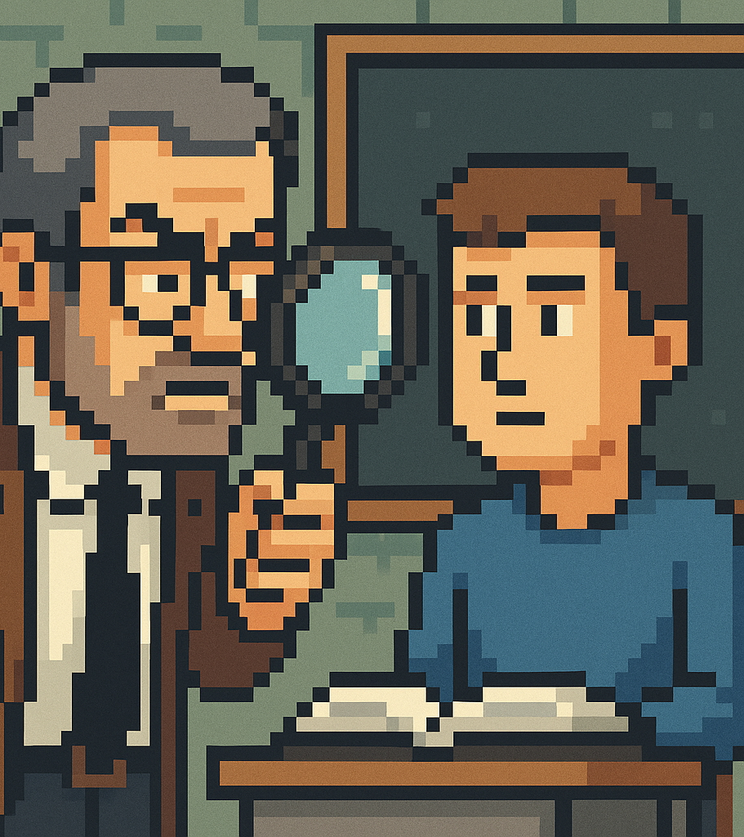
Myth 1: “I Know It When I See It”
Assumption: Faculty can spot AI writing
Reality: Detection is unreliable and biased
Move past it: Design for transparency
Ask students to explain their thinking and process
Notes:
Zach
What are the AI writing characteristics we’re always told to watch out for?

Slide 4

Myth 2: “AI Can’t Do Personal Reflection”
Assumption: Reflection is AI-proof
Reality: AI can generate personalized responses
Move past it: Use reflection for learning
Connect experience, concepts, and judgment
Notes:
Nik

Slide 5
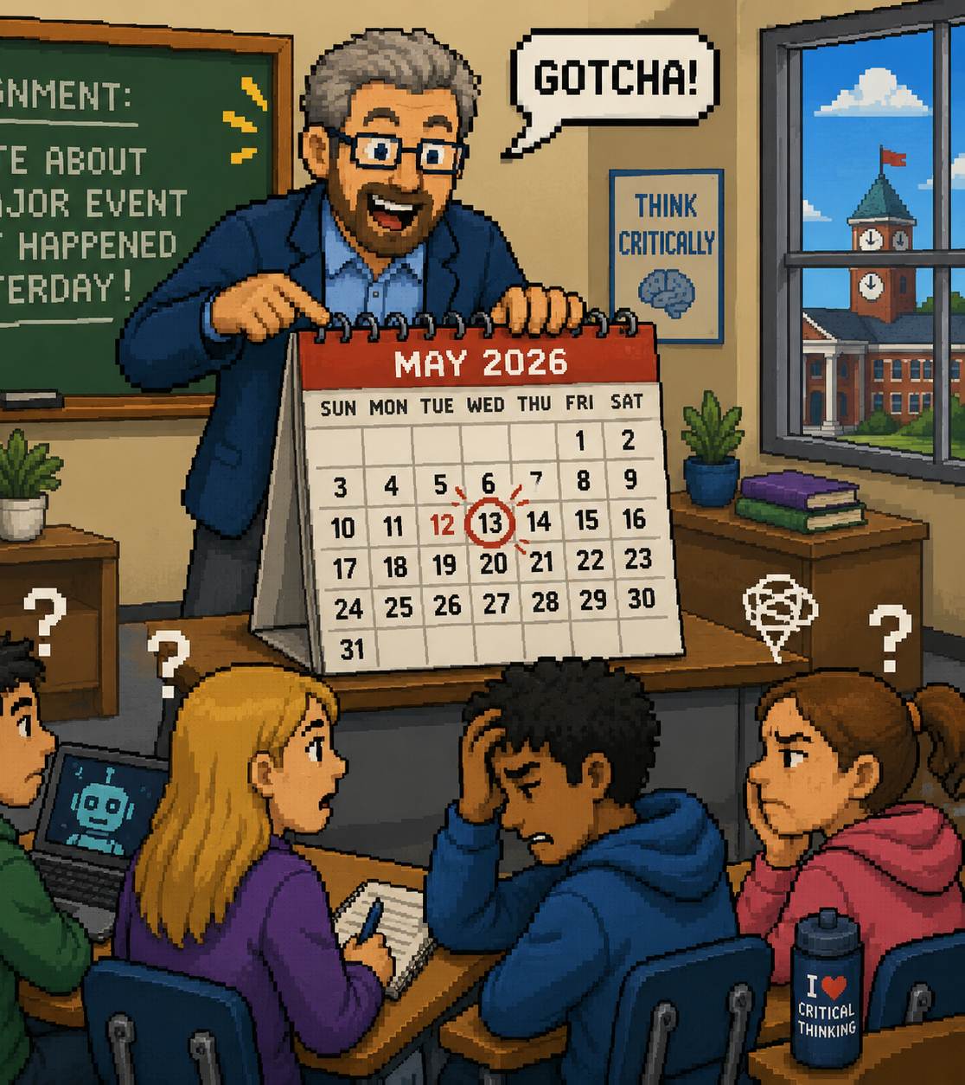
Myth 3: “The Calendar Trick”
Assumption: Recent events block AI use
Reality: AI can access current information
Move past it: Use relevance, not restriction
Focus on why current events matter
Notes:
Zach

Slide 6
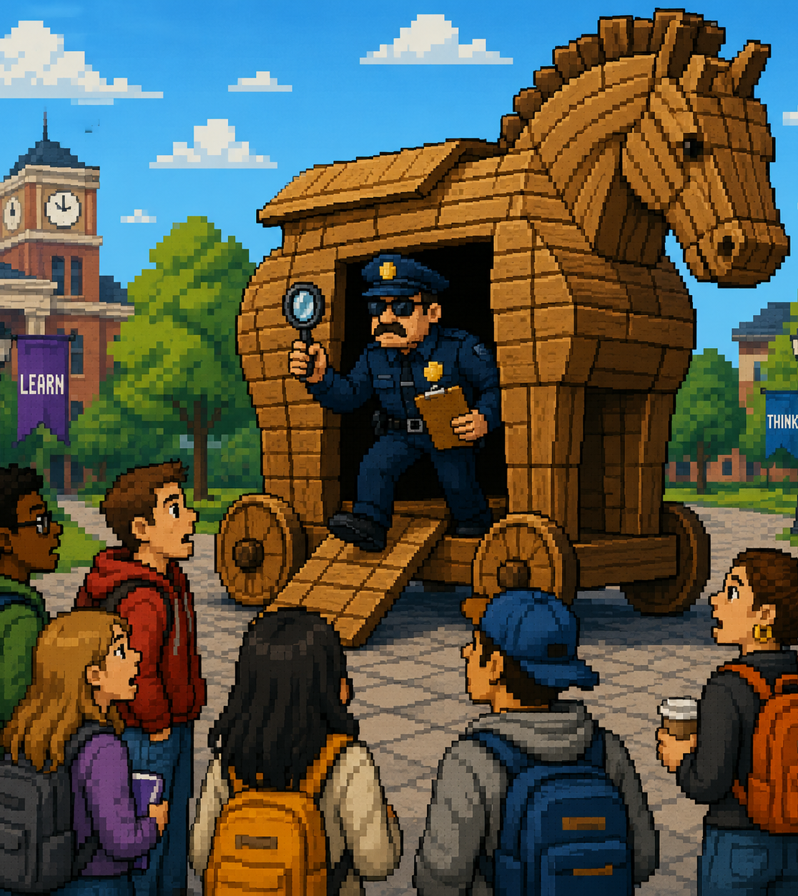
Myth 4: “Trojan Horse”
Assumption: Hidden prompts can catch AI
Reality: Unreliable and undermines trust
Move past it: Be explicit and transparent
Design meaningful, open assignments
Notes:
Nik
Draw on some of the specifics in the article (came from a TikTok channel. This is the classic one weird trick to destroy ChatGPT)
Q: What are some of the issues with this approach?

Slide 7
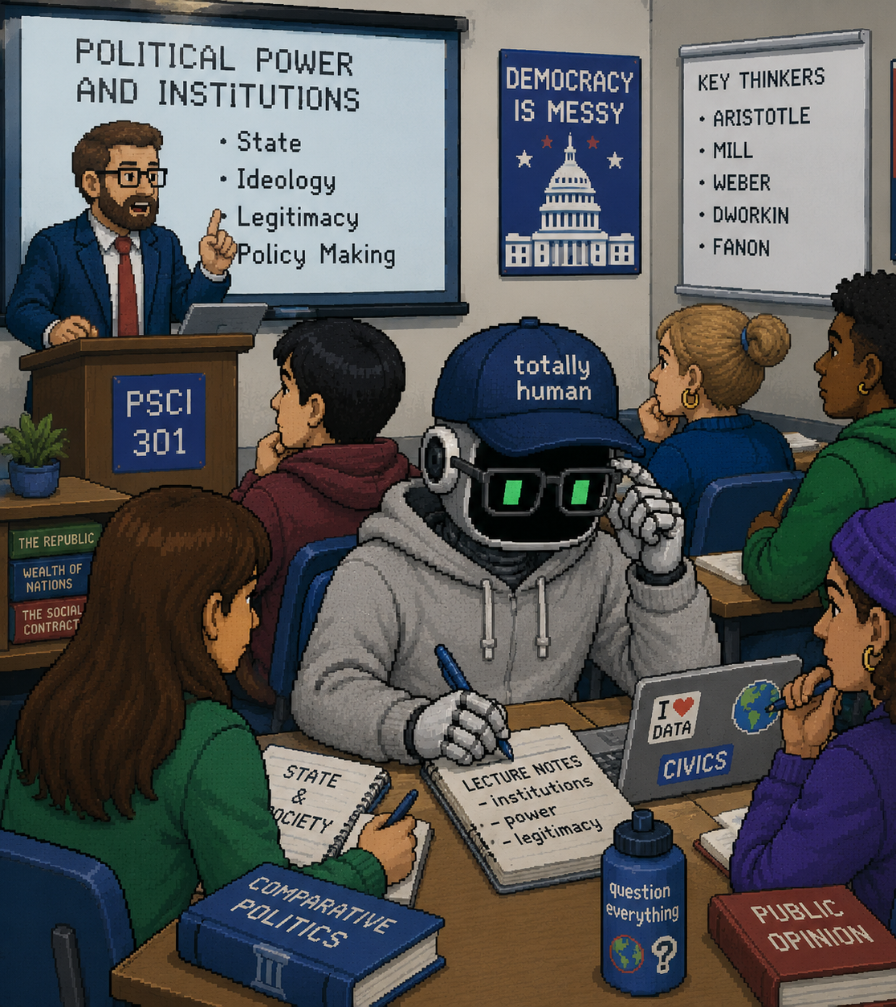
Myth 5: “Claude’s Not in Our Classroom”
Assumption: Class-specific content prevents AI use
Reality: Students can include context in prompts
Move past it: Integrate context intentionally
Use this to build AI literacy
Notes:
Zach

Slide 8
What Opens Up When We Move Past These Myths
Less time on detection
More focus on learning design
Clearer AI-use expectations
Stronger emphasis on AI literacy
Better conversations about curriculum and future work
Notes:
Nik

Slide 9
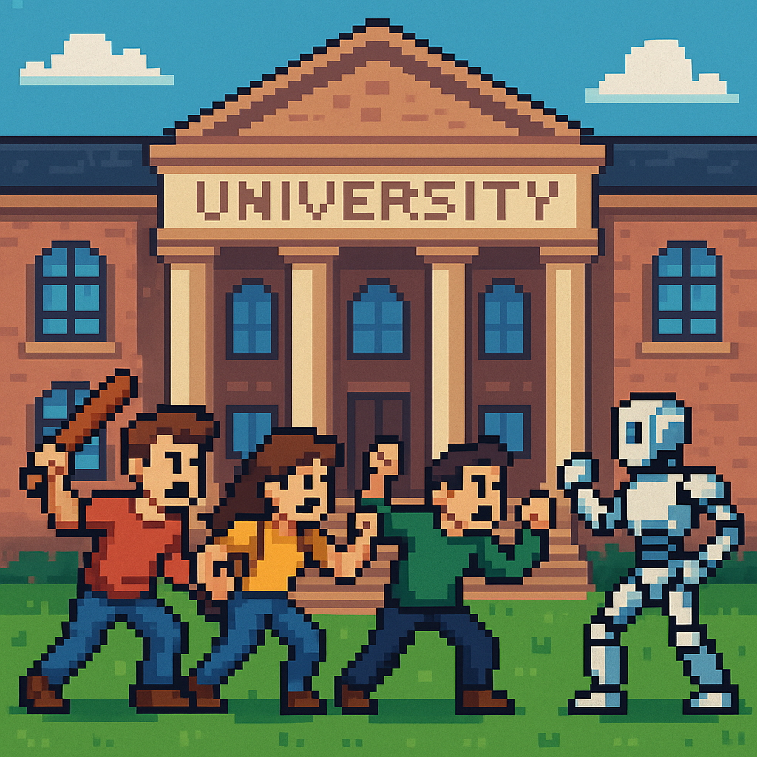
The goal is not to “win” against AI, but to prepare students for learning and work in an AI-present world.
Notes:
Nik

Slide 10

Thank you!
Nik Janos
njanos@csuchico.edu
Zach Justus
zjustus@csuchico.edu
Find us:
Melts Into Air, meltsintoair.org
Unfixed Podcast, on all podcast platforms
Subscribe:
Unfixed Newsletter—The AI Higher Ed Breakdown
www.onehe.org

