Slide 1



Develop your teaching your way
The AI Educational Double Bind: When to Lean In, and When to Refuse
Kevin Yee, UCF
www.onehe.org

Slide 2

Kevin Yee
Special Assistant to the Provost for Artificial Intelligence
Director, Faculty Center for Teaching and Learning
University of Central Florida

Slide 3

“Lean In”
Notes:
Our current guidance: teach both halves of the double-bind at some point in the curriculum
Left side w/ hatching: lean in
Right side w/o hatching: lean out
These quadrants don’t line up exactly with the Institute days, but all are in there

Slide 4

What are the elements of AI fluency?
Notes:
- GenAI really feeds some of these reasons (esp. 3, 4, and 5)

Slide 5

AI Fluency
Understanding how AI works
Ethics of AI / When to use it
Choosing proper AI tools
Effective prompt engineering
Displaying digital adaptability
Evaluating AI output and adding human value
Notes:
“Get an AI output and DO SOMETHING with it” – red zones are what our assignments should “be” (black items happen alone? DB assignments?). Literacy (can read) vs fluency (can use)

Slide 6



EVALUATE
Tell students to first obtain an argument from the LLM, then craft a rebuttal.
Notes:
Kevin
“Advance the argument that although electric vehicles
do not consume gasoline, their carbon footprint is still
significant, even when compared to gasoline-powered
cars.”

Slide 7

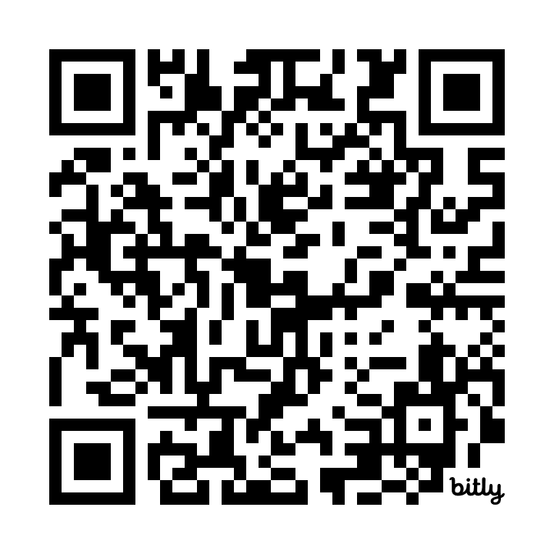
https://bit.ly/chatgptassignments
Notes:
Kevin

Slide 8
“Lean In”
Notes:
Our current guidance: teach both halves of the double-bind at some point in the curriculum
Left side w/ hatching: lean in
Right side w/o hatching: lean out
These quadrants don’t line up exactly with the Institute days, but all are in there

Slide 9


Skill Erosion
Notes:
https://www.thelancet.com/journals/langas/article/PIIS2468-1253(25)00133-5/abstract

Slide 10

How Can We Prevent Idiocracy?
2006

Slide 11
“Lean In”
“Informed Refusal”
Notes:
Our current guidance: teach both halves of the double-bind at some point in the curriculum
Left side w/ hatching: lean in
Right side w/o hatching: lean out
These quadrants don’t line up exactly with the Institute days, but all are in there

Slide 12
Why do students cheat?
Notes:
- GenAI really feeds some of these reasons (esp. 3, 4, and 5)

Slide 13

Reasons Students Cheat
Why Students Cheat
I’m only extrinsically motivated (degree gets me a job)
Everyone else does it (I’ll fall behind if I don’t cheat like them)
It’s not morally/ethically wrong (victimless crime)
I’m not going to get caught
I need to cheat to pass (don’t have enough time)
Notes:
- GenAI really feeds some of these reasons (esp. 3, 4, and 5)

Slide 14
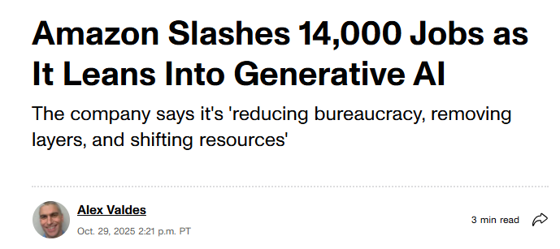
“Better than AI”

Slide 15
Reasons Students Cheat
Why Students Cheat
I’m only extrinsically motivated (but I need to be “better than AI” in today’s market)
Everyone else does it (I stand out in the job market when I don’t use AI)
It’s not morally/ethically wrong (I want to be actually prepared)
I’m not going to get caught (but I WOULD get caught on the job later if I cheat)
I need to cheat to pass due to time (passing won’t do me any good without skills)
Notes:
- GenAI really feeds some of these reasons (esp. 3, 4, and 5)

Slide 16

tl;dr
The process is the point!
AVOIDING the shortcuts is how you stand out to employers

Slide 17
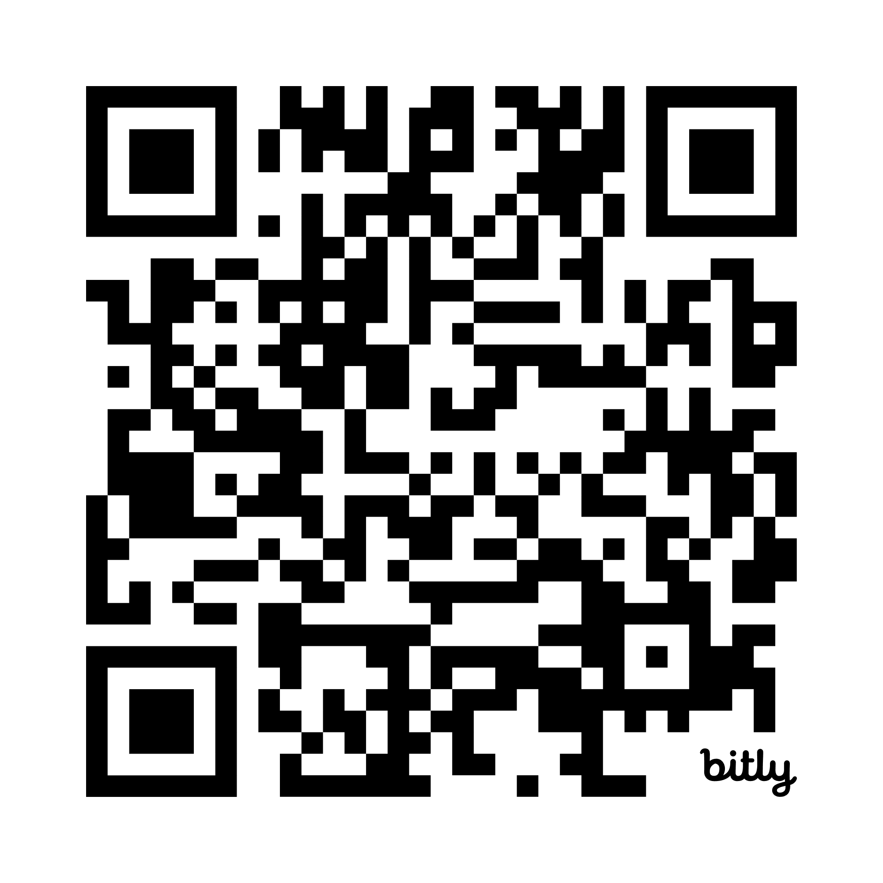
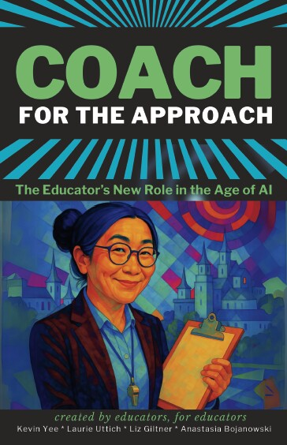
https://bit.ly/CoachForTheApproach

Slide 18
“Lean In”
“Informed Refusal”
Notes:
Our current guidance: teach both halves of the double-bind at some point in the curriculum
Left side w/ hatching: lean in
Right side w/o hatching: lean out
These quadrants don’t line up exactly with the Institute days, but all are in there

Slide 19
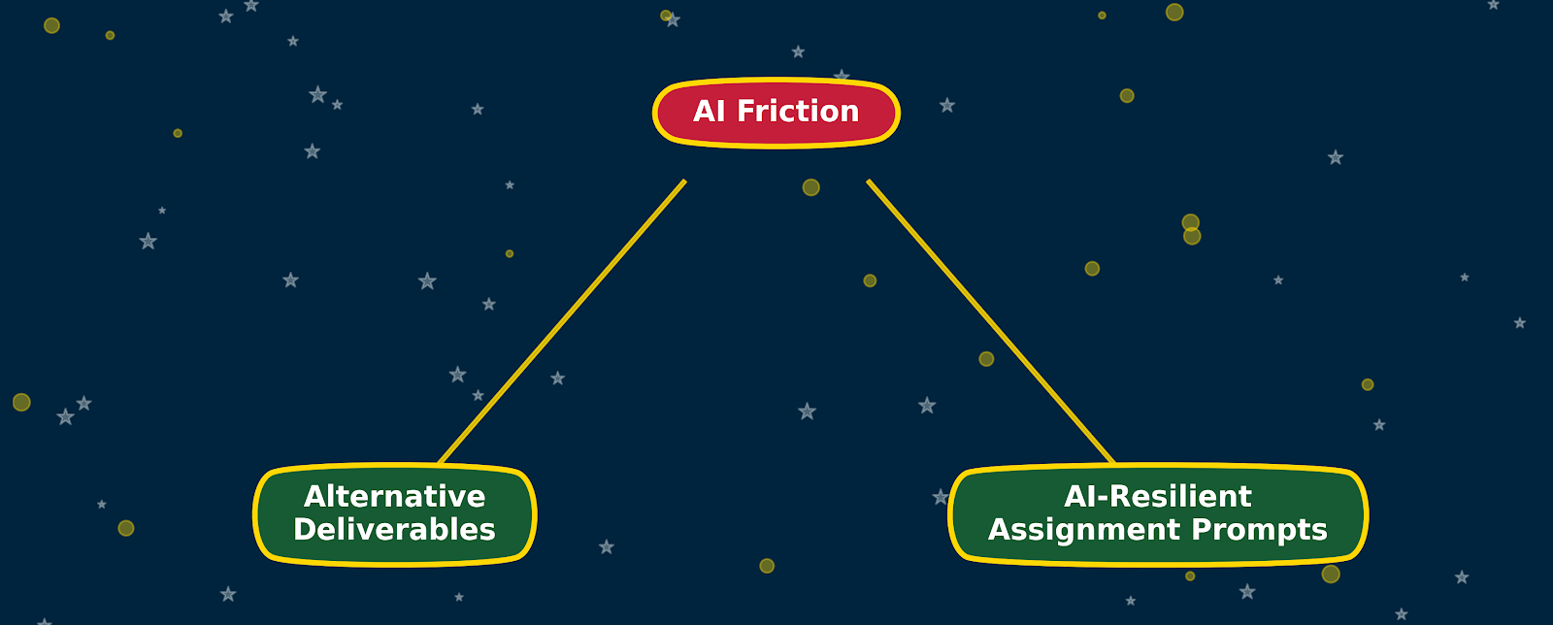
How to Create AI Friction

Slide 20

Authentic Assessment
Definition: students create something using their learning that applies to a real-world context (case studies, simulations, portfolios, project-based learning)
Scaffold into smaller tasks and deliverables
Include reflective activities
Notes:
Normally, authentic assessment is doing the actual work (a test, and even an essay, is not ‘authentic’)

Slide 21
Authentic Assessment: Prompt
In this project, you will apply course concepts to analyze a real, local business (or campus organization) and develop a set of actionable recommendations that could realistically be implemented. This mirrors consulting work done in business environments and encourages you to use your learning to solve real problems.
Overview of the task: Select a local business, nonprofit, or campus-based enterprise. Your task is to:
Understand their current business context
Identify a strategic challenge they are facing (e.g., marketing, operations, customer experience, financial sustainability)
Propose evidence-based solutions using course models and frameworks
You will present your recommendations to the class (and optionally to the business owner).
Notes:
Example from business

Slide 22
Authentic Assessment: Final Presentation
Your presentation should include:
Brief overview of the business
Clear statement of the strategic challenge
Data or evidence supporting the challenge (customer feedback, observation, interview insights)
Proposed solutions tied directly to course frameworks
Feasible implementation steps (timeline, roles, required resources)

Slide 23
Authentic Assessment: Reflection
After the final presentation, write a 2–3 page reflection that addresses:
What did you learn about applying business theory in real contexts?
What changed in your understanding of how organizations solve problems?
How did your team collaborate and what would you do differently next time?
What surprised you in working with/learning about a real organization?

Slide 24

Diffuse Assignment Prompts
Make it “uphill work” for students to paste the elements of the assignment prompt directly into AI. Instead, have them draw on multiple resources within the online course
Intentionally choose resources that ONLY exist in the online course
Choose multiple references so at least it’s not “easy” to just paste the prompt to AI

Slide 25
Diffuse Assignment Prompts
Assignment: Operations Improvement Proposal for a Real Business Client. You will analyze and recommend an improvement to one operational process in a real or hypothetical organization. Your proposal must be grounded in three course materials located in different places in the online course: Operations Process Map Template (Module 3 PDF), Lean Principles Mini-Lecture (Module 4 video), and Kenco Logistics Case Study (Module 5 PDF)
Deliverables (1000 words): A completed process map of the current workflow. Identification of two types of waste (referenced from the Lean video; cite the timestamp). A structured improvement plan modeled after the Kenco Case (include one quoted sentence as justification). A reflection paragraph explaining what parts of this work were assisted by AI (if any), how you verified accuracy, and what revisions you made to ensure your voice and reasoning remained central.
Notes:
Example from business

Slide 26
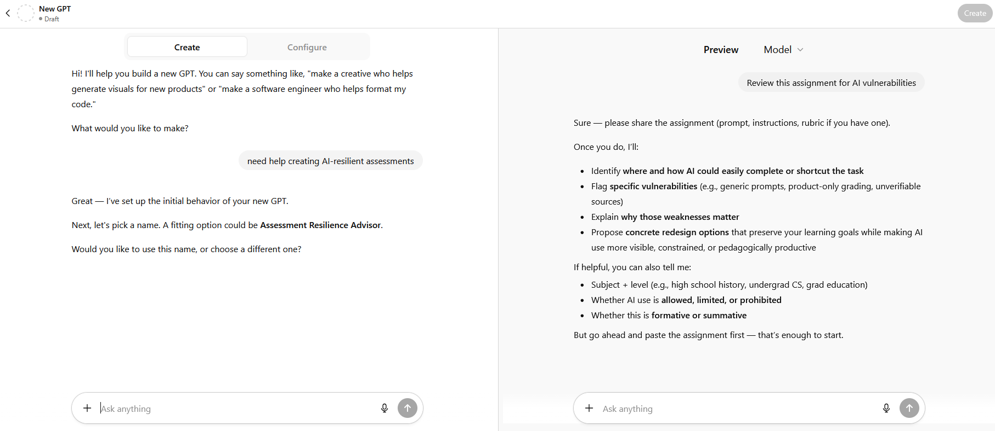
Custom GPTs to the Rescue!
Notes:
https://chatgpt.com/g/g-69401d84d314819192f49998563402dd-assessment-resilience-advisor
You can read my ChatGPT resilience GPT from a distance, but not my copilot

Slide 27
List some alternative deliverables
Notes:
- GenAI really feeds some of these reasons (esp. 3, 4, and 5)

Slide 28


Capstone Exams

Slide 29

Oral Exams / Recorded Video
LLMs CAN provide the script, but most students rehearse so much they learn the content anyway
We will later discuss convincing students not to take AI shortcuts – keep this one in mind then, too

Slide 30

Return to Bluebooks: Might be unfair to some students.
Consider: handwriting skills, slower thinkers, neurotypicality

Slide 31
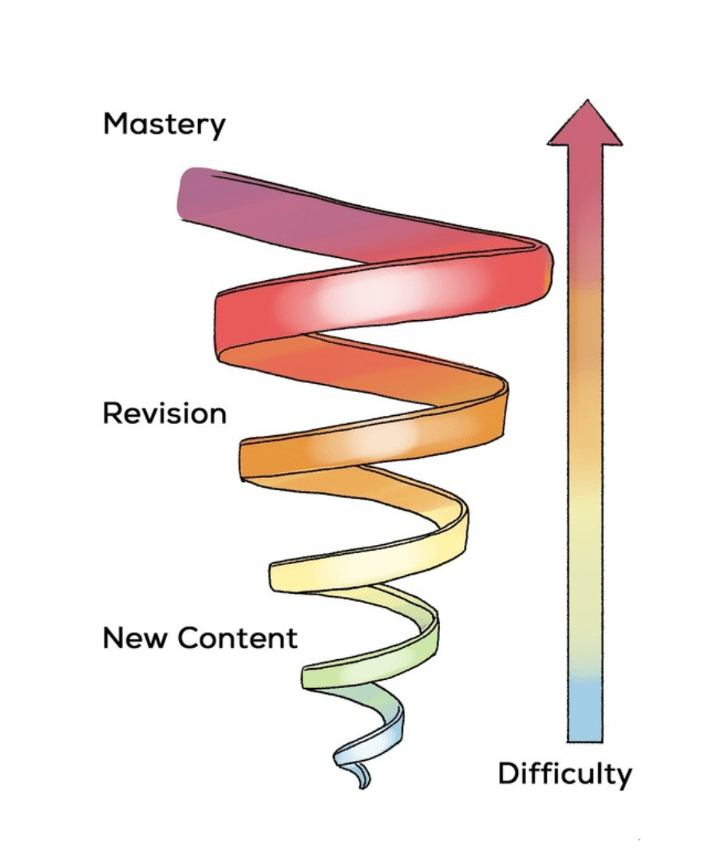
Notes:
Right hemisphere: lower division. Risky to do co-creation in lower division

Slide 32


Develop your teaching your way
Thank you!
support@onehe.org
www.onehe.org

