Slide 1



Develop your teaching your way
What’s Burning Out Faculty?
An Evidence-Based Approach to Faculty Wellbeing
Andrea Aebersold, Ph.D.
Joy Honea Ph.D.
www.onehe.org

Slide 2

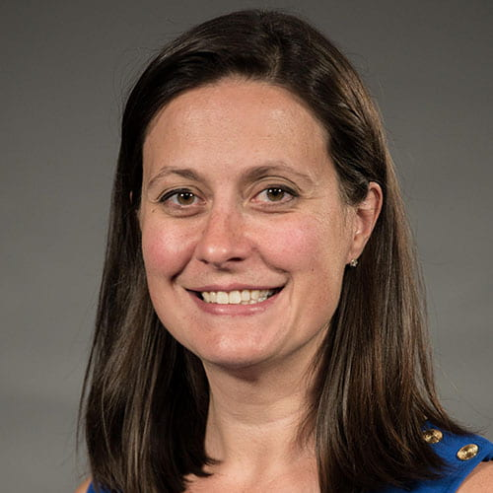
Andrea Aebersold
Executive Director,
Center for Teaching and Learning
Montana State University Billings

Slide 3
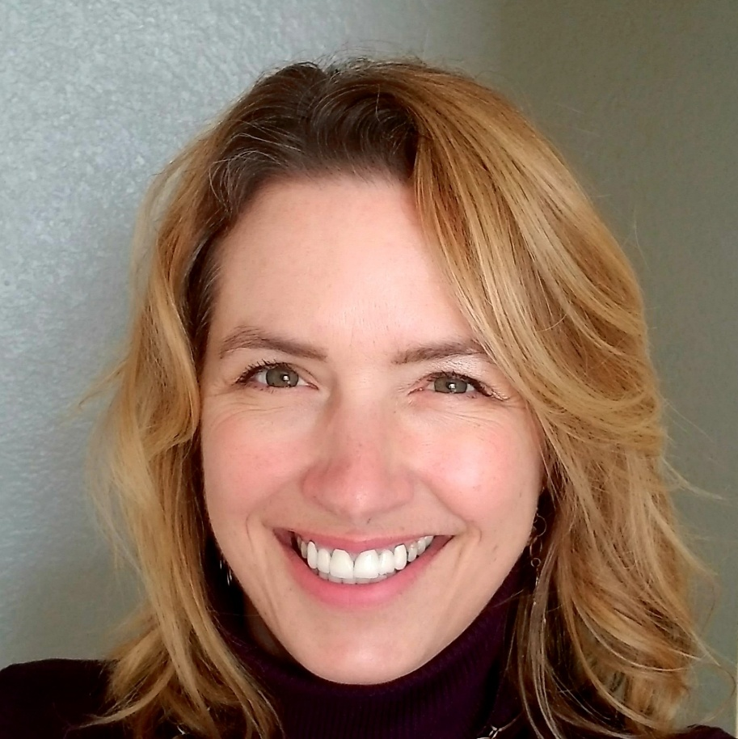
Joy Honea
Professor of Sociology
Faculty Association President
Montana State University Billings

Slide 4

Participant Prompt
In the chat, briefly tell us – what conversations about faculty wellbeing are happening at your institution?

Slide 5
Research Project
What percentage of faculty report feeling burned out?
What do faculty cite as factors in their burnout?

Slide 6
Faculty Wellbeing Project
Multi-year study to measure levels and leading causes of faculty burnout at our institution
Recommend evidence-based institutional changes to support faculty wellbeing
Incorporate faculty wellbeing in CTL programming/support
Assess impact of institutional changes

Slide 7
Faculty Wellbeing Project
YEAR ONE (2023-2024): DATA COLLECTION
  Fall 2023: initial focus groups and survey of faculty.
  Spring 2024: second round of focus groups.
YEAR TWO (2024-2025): CAMPUS RECOMMENDATIONS AND FURTHER DATA COLLECTION
  Fall 2024: data analysis and recommendations for institutional changes.
  Spring 2025: interviews with department chairs about workload inequity.
YEAR THREE (2025-2026) GRANT SUPPORT (OR NOT)
  Awarded NSF ADVANCE Grant for 2025 – 2027 (cancelled by federal executive order)
  Rework CTL and institutional planning.
  Spring 2026: Interviews with faculty following revision of performance evaluation criteria.

Slide 8
Faculty Focus Groups (Fall 23)
Session #1 – Culture of Academia
Session #2 – Impostor Syndrome and Burnout
Session #3 – Work/Life Balance
Session #4 – Finding Support/Next Steps

Slide 9
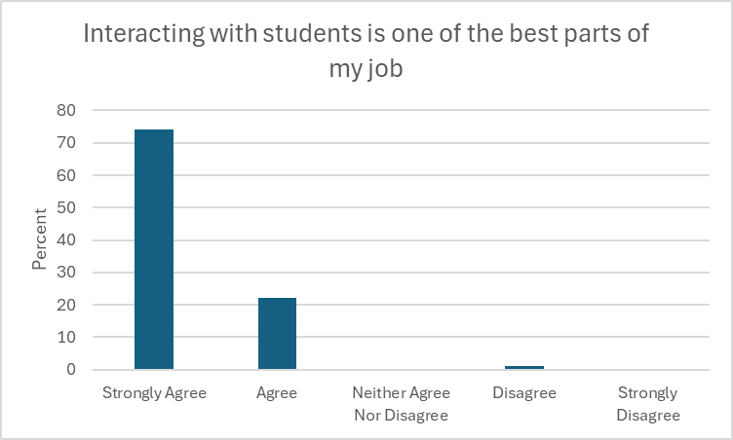
Survey Results
Faculty enjoy working with students! 96% either strongly or somewhat agree with the statement, “Interacting with students is one of the best parts of my job.”
54% response rate

Slide 10
Overall Study Results
Levels of Burnout and Emotional Exhaustion:
Quantitative Findings:
“I regularly feel overwhelmed or burned out about my job.”
  57 percent agreed with the statement. (Highest rates among tenured faculty-70%, compared to 52% among pre-tenure faculty.)
“I often feel emotionally exhausted by my job.”
  50 percent agreed. (Extremely high rates for tenured faculty, at 84%.)
“I would like to have more time to dedicate to scholarly development (i.e., research/scholarship.)”
  96% of tenure-track and 100% of tenured faculty with research responsibilities agreed.
“I regularly feel like I have to prove that I’m doing a good job.”
  66% agree (Highest for probationary but nearly 2/3 of tenured faculty.)
“If I take time off, there are other people who can take over my duties for a time.”
  63 percent of respondents disagreed.

Slide 11
Overall Study Results, Cont.
Factors Contributing to Faculty Burnout:
Qualitative Findings:
  Responsibility creep interferes with aspects of the job that faculty like most, especially teaching and research:
  “I guess MSUB doesn’t want me to succeed.”
  “I’m tired of half-assing my teaching.”
  Understaffing and turnover contribute to overwork among faculty:
  “It’s not even MY workload that’s the problem. It’s having to do everything else.”
  “New staff don’t know what they are doing. I’m tired of cleaning up other people’s messes.”
  3. Lack of clarity in evaluation process leads to faculty anxiety:
“Unwritten rules” make performance standards seem like “a moving target.”
This leaves little time for scholarship, and, for tenure/promotion, “that’s what will make or break it.”

Slide 12
Overall Study Results: Conclusions
These factors lead to low morale and faculty disillusionment:
“It’s like there are always little fires everywhere.”
“You always have to be fighting (over scarce resources.)”
“I sometimes have fantasies of not ever coming back to work.”
Solutions need to be institutional, not individual:
“What I really would like, in a nutshell, is just more time to work on my own projects (and not that of the department/university), more time with my family, and time to take care of my own basic needs such as exercise, eating well and getting enough sleep. I don't need more education on these things--I just need time to take care of them.”

Slide 13

Campus Plan
Faculty Recommendations:
Hire more faculty (#1 response.)
Equalize the service load (and fewer committees/meetings.)
Hire and retain competent staff.
Offer more opportunities for course releases for research. ✓
Clarify faculty duties/expectations of performance.
Research Team Recommendations:
Leadership training for chairs/deans.
Develop clear processes/expectations for faculty evaluation. ✓
A campus audit of service duties.
More faculty to relieve overload teaching, including the creation of a qualified adjunct pool.

Slide 14
Zoom Poll
How confident are you that a similar initiative could be implemented at your institution?

Slide 15

Taking Action on Solutions
Don’t assume levels/causes of burnout – get some data
Identify and leverage partnerships
Make a plan and measure its impact
CTLs as advocates, working behind the scenes

Slide 16
Participant Prompt
Who would be good partners at your institution?

Slide 17
Action Planning
In thinking about the obstacles to faculty well-being at your institution, and what is currently being done to address them, what would you need to start/continue this work? Consider the following:
  Campus partners
  Buy-in from which leaders
  Programming
  Resources
What is one step you can take when you return to your institution?
Work on individually then share in small groups

Slide 18

In Conclusion
This individual case study is not a roadmap, but inspiration for your own plans.
Each institution is unique. Causes and consequences of burnout will differ, as will the solutions and feasibility of strategies.

Slide 19


Develop your teaching your way
Thank you!
support@onehe.org
www.onehe.org

