Slide 1



Develop your teaching your way
Exploring the Ethics of GenAI
Cate Denial, Knox College
www.onehe.org

Slide 2


Cate Denial
Bright Distinguished Professor of American History
Director of the Bright Institute
Associated Colleges of the Midwest Leadership Fellow

Slide 3
For those with reading or vision difficulties I will read the text on each slide aloud
Images from pexels.com

Slide 4
Generative AI:

Slide 5
Generative AI:
What I cannot do
Provide the magical one-size fits all fix-it to this situation

Slide 6
Generative AI:
What I cannot do
What I can do
Provide the magical one-size fits all fix-it to this situation
Suggest some different ways to approach the problem of generative AI

Slide 7
Where to begin?

Slide 8
Where to begin?
There are no reliable tools that can detect the use of ChatGPT and its ilk

Slide 9
Where to begin?
Em dashes are not a sign of GenAI use

Slide 10
Where to begin?
Long words are not a sign of GenAI use

Slide 11
Where to begin?

Slide 12
Where to begin?
TRUST
Our classrooms are not full of students with nefarious intentions

Slide 13
Where to begin?
TRUST
Our classrooms are not full of students with nefarious intentions
TRANSPARENCY
Can we articulate the reasons behind our pedagogical choices in positive terms?

Slide 14
Landed on Ethics

Slide 15
At its best, post-secondary education is all about encouraging critical thinking

Slide 16
What do our students need to know to make educated decisions about generative AI?

Slide 17
There were many things with which I wanted students to grapple

Slide 18

How LLMs work
ChatGPT and other similar products do not generate knowledge, but instead work by means of sophisticated predictive text operations. See:
Mark Riedl, Medium

Slide 19

Labor practices
“To teach Bard, Bing or ChatGPT to recognize prompts that would generate harmful materials, algorithms must be fed examples of hate speech, violence and sexual abuse.”
Niamh Rowe, The Guardian

Slide 20
Labor practices
“Stress, low pay, minimal instructions, inconsistent tasks, and tight deadlines—the sheer volume of data needed to train AI models almost necessitates a rush job—are a recipe for human error.”
Matteo Wong, The Atlantic

Slide 21

The environment
AI needs water to generate the electricity that powers servers, and water to cool them. The ethical considerations are enormous when we consider global water shortages, climate change, and profit motives.
See: The Environmental Impacts of AI & Vishwam Sankaran, The Independent

Slide 22
The environment
“Physical infrastructure includes electrical hardware, GPUs, processors, and cooling systems. According to Shift Project researchers, the sector is on ‘an unsustainable climate trajectory.’”
Camille Rustici, Direct Industry

Slide 23

Disability
AI innovation is predicated upon eugenicist beliefs – that humans need to be perfected through technology. See Rua M. Williams new book, Disabling Intelligences: Legacies of Eugenics and How We are Wrong About AI.

Slide 24

Access
Developers are moving to become the first in the field, not to think about access. See:
Laurie Henneborn, Harvard Business Review

Slide 25

Reality
“Part of what keeps us sane is other people’s perspectives, which are often in tension with ours. . . .When you say something questionable, others will challenge you, ask questions, defy you. It can be annoying, but it keeps us tied to reality, and it is the basis of a healthy democratic citizenry.”
Carissa Véliz, in “Man Goes Missing after AI Chatbot Obsession”

Slide 26
Reality
“Truth is intersubjective, meaning that we need other people — their testimony, their experiences, their rationality — to be well
informed. And chatbots are not people. They don’t have experience. They are not witness. They are fancy wordplay.”
Carissa Véliz, in “Man Goes Missing after AI Chatbot Obsession

Slide 27

Data Mining
It’s important that students know what happens to the data that they provide to AI systems. See:
Matt Burgess, Wired

Slide 28

How we talk about AI
“New technologies need simple metaphors to thrive.”
Eric Salvaggio, Challenging the Myths of Generative AI

Slide 29
How we talk about AI
“Myths and metaphors aren’t just rhetorical flourishes; they are about power. They tell us who has it, who should have it, how they should use it, and in the service of what goal.”
Derek Stone, quoted in Eric Salvaggio, Challenging the Myths of Generative AI

Slide 30
Students read these articles. Then what?

Slide 31
Reading Reflections
ungraded; completed after every reading

Slide 32

What new things did you learn from the reading?
What do you think it’s important we talk about today?
What left you confused? What questions do you have?
Is there anything else you want to share?

Slide 33
Responses
(anonymized, and used with permission)
Wendy
Emily
Vic
Dakota
“I have never heard about this before”
“I did not know anything about this topic”
“Thank you for having us learn about this! I’m really glad I know about it now”
“Thank you for bringing this issue to my attention. I didn’t know anything about it!”

Slide 34

Responses
“I think it's important that we go beyond the conversations about academic integrity surrounding ChatGPT to address the effects that AI is having on folks, including children, in the global south and think about why this is not a bigger part of the conversation around the ethics of AI.” (Dakota)

Slide 35
Responses
“Most of the time we only talk about AI in terms of academic integrity (which is important) but this information frames it in a new way” (Jordan)

Slide 36
Responses
“As a society I feel like we never care about what goes on behind closed doors, instead we are content with the shiny new toy and want to see what it can do, and leave the rest for someone else to worry about.” (Jean)

Slide 37
Responses
“We are asking the wrong questions: ‘Can we do this’ instead of ‘should we.’” (Alex)

Slide 38
Scaleable

Slide 39
Scaleable
Polls
take the temperature of the room on issues related to generative AI and see the results in graph or pie-chart form

Slide 40
Scaleable
Polls
Position statements
take the temperature of the room on issues related to generative AI and see the results in graph or pie-chart form
have students do the metacognitive work to articulate their position on generative AI. Will they use it? In what ways? To achieve what ends? If they won’t use it, what has shaped that decision?

Slide 41
Draft and redraft

Slide 42
Draft and redraft
Have students write for homework

Slide 43
Draft and redraft
Have students write for homework
In-class peer review

Slide 44
Draft and redraft
Have students write for homework
In-class peer review
In-class time for redrafting

Slide 45
Draft and redraft
Have students write for homework
In-class peer review
In-class time for redrafting
Scissors day!

Slide 46
Draft and redraft
Have students write for homework
In-class peer review
In-class time for redrafting
Scissors day!
Have students take a quiz

Slide 47
Draft and redraft
Have students write for homework
In-class peer review
In-class time for redrafting
Scissors day!
Have students take a quiz
Class review

Slide 48
Draft and redraft
Have students write for homework
In-class peer review
In-class time for redrafting
Scissors day!
Have students take a quiz
Class review
Time in class to rework answers

Slide 49
Draft and redraft
Have students write for homework
In-class peer review
In-class time for redrafting
Scissors day!
Have students take a quiz
Class review
Time in class to rework answers
Critical thinking skills

Slide 50
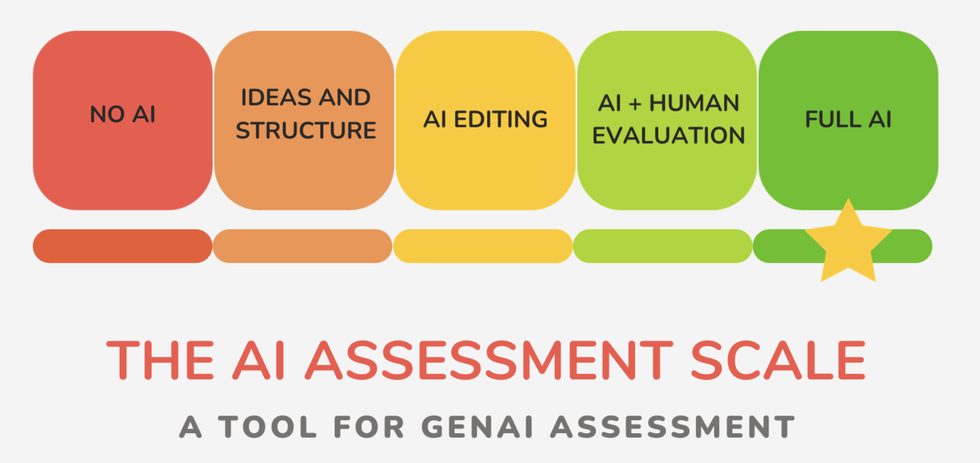
www.leonfurze.com

Slide 51
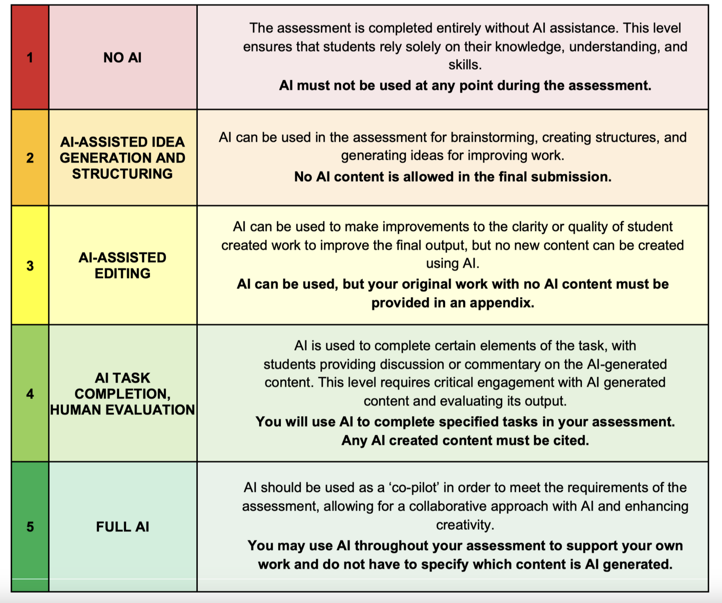
www.leonfurze.com

Slide 52
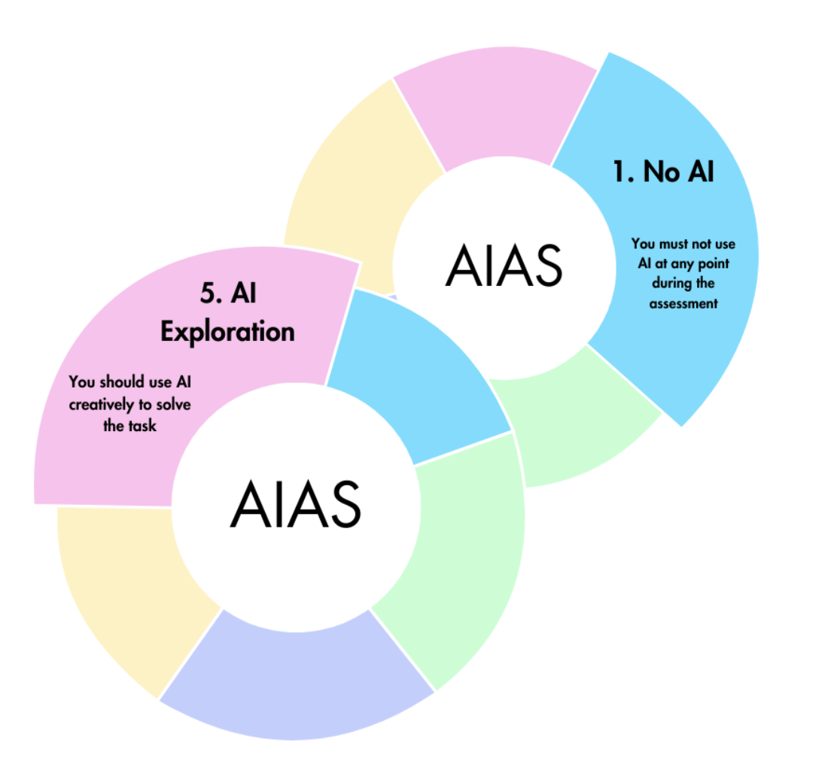
www.leonfurze.com

Slide 53

Time with students

Slide 54
Time with students
Meet one-on-one or in small groups with students

Slide 55
Time with students
Meet one-on-one or in small groups with students
Ask questions and design assignments that give them the opportunity to work through their thinking

Slide 56
For more articles on ethics and AI see: https://catherinedenial.org/blog

Slide 57

Develop your teaching your way
Thank you!
support@onehe.org
www.onehe.org

