Slide 1



Develop your teaching your way
Transparency
in Learning and Teaching
Emily O. Gravett
www.onehe.org

Slide 2
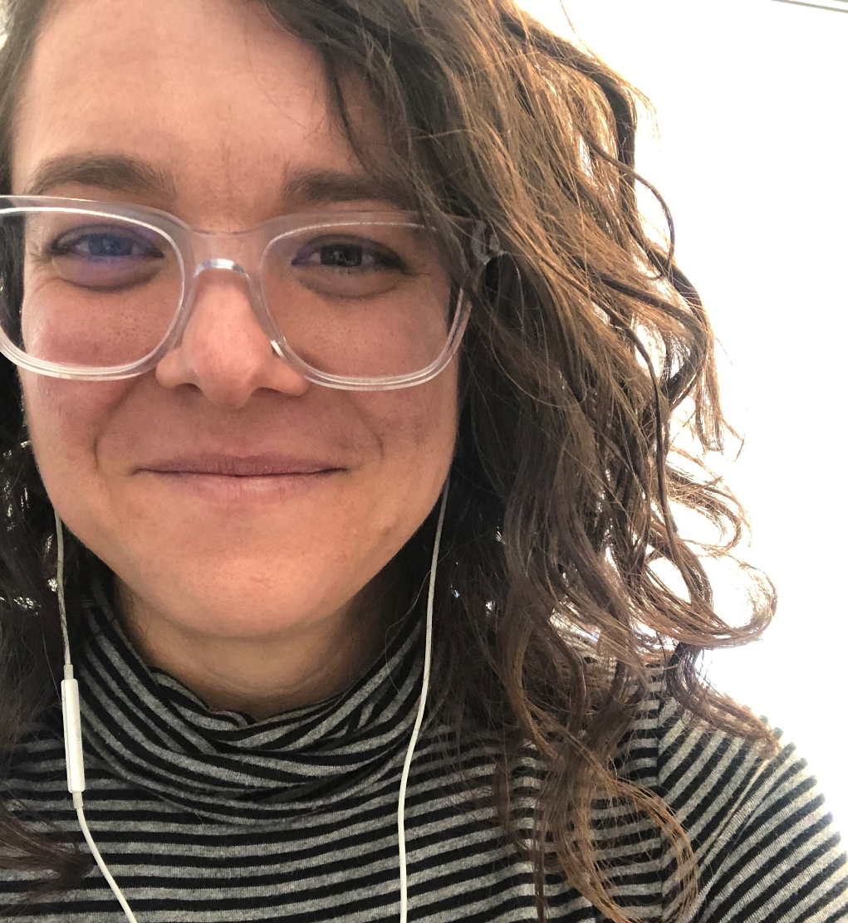
Emily O. Gravett
Associate Professor, Religion
James Madison University
USA

Slide 3
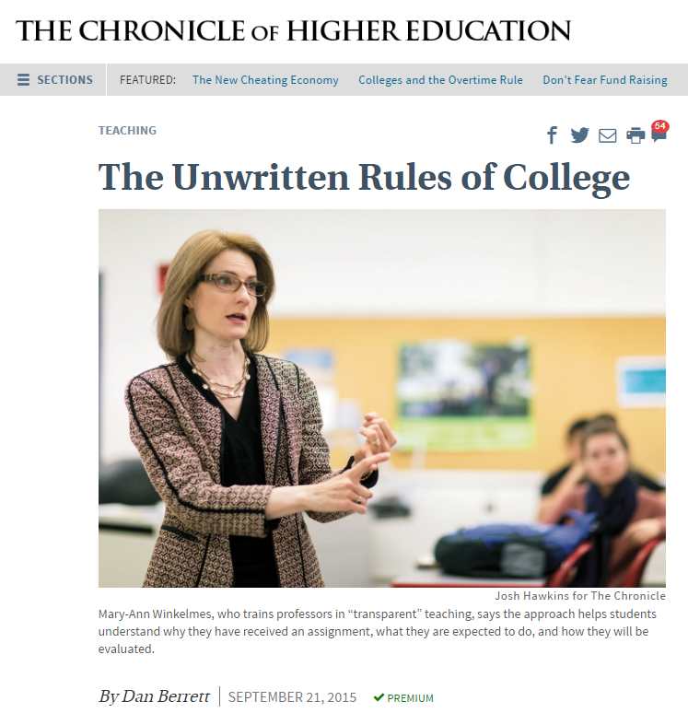
Research into Transparency
Peer Review research (2016)
https://tilthighered.com
Notes:
TILT (Transparency in Learning and Teaching in higher ed) project:
7 schools (of varying size and classification), 1800 students, 35 faculty
Faculty were trained to make two take-home assignments more transparent; each faculty member taught two class groups of same course; one class group received the intervention (the transparently revised assignments according to the template), the other did not
Effect measured by amount of transparency students perceived; students’ self-ratings of 3 important predictors of success (academic confidence, sense of belonging, improved mastery of skills that employers value), which we know lead to higher GPAs as well as persistence and retention; direct assessment of students’ work; and short-term retention rates
“The endeavor has identified a simple replicable teaching intervention that demonstrably enhances students’ success, especially that of first-generation, low-income, and underrepresented college students in multiple ways at statistically significant levels, with a medium to large magnitude of effect” (i.e., good for all, but especially most vulnerable/underserved)

Slide 4

Three Principles of Transparency
Purpose
Task
Criteria

Slide 5
Purpose
What skills and/or knowledge will the assignment help students learn?
Are there clear learning objectives for the assignment?
How do these objectives align with your overall course goals?
Why is the assignment important in class and beyond, in the “real world”?
That is: what’s the point?
Notes:
~ Bloom’s taxonomy (remember → create), Fink’s taxonomy (application, learning how to learn, etc.)

Slide 6
Purpose EXAMPLE
The purpose of the exercise is twofold: first, to simulate the process developmental biologists go through in the laboratory when observing a novel mutant, and second, to help you think about downstream physiological effects of loss of function of various genes.
This assignment will help you practice the following skills:
Observing and describing a mutant phenotype as compared to wild-type organisms….
Notes:
Multi-disciplinary examples of more and less transparent assignments can be found at the TILT Resources page
For the full Biology 111L assignment quoted on this slide and later slides, check out
https://bdl2jezatgadvbda.public.blob.vercel-storage.com/pdf/Example%20E-NRw8cAFNKHd2ph4RgZPaTMBxqBX00H.pdf

Slide 7
Task(s)
Does the kind of assignment make sense, given its purpose?
How can you make the genre or type of assignment explicit?
Who is the audience and what role(s), if any, should students inhabit?
Is there an order or steps that students should follow?
Are there any pitfalls to avoid along the way?
That is: What are you asking students to do and how?
Notes:
~ Scaffolding, step-wise, sequencing

Slide 8
Task EXAMPLE
This exercise asks you to think about a series of C. elegans mutants. All of these mutants survive to adulthood, but display phenotypes that are based on underlying developmental defects. For each mutant, examine the images and watch the associated video (linked on Blackboard). Then, answer the following questions for each mutant:
1. Describe the phenotype of the mutant. How does it differ from wild type worms?
2….
Notes:
Multi-disciplinary examples of more and less transparent assignments can be found at the TILT Resources page
For the full Biology 111L assignment quoted on this slide and later slides, check out:
https://bdl2jezatgadvbda.public.blob.vercel-storage.com/pdf/Example%20E-NRw8cAFNKHd2ph4RgZPaTMBxqBX00H.pdf

Slide 9
Criteria
By what standards will the assignment be graded?
What checklist of expectations or requirements can guide students?
Have these criteria been conveyed in advance?
What opportunities will students have to practice before the deadline?
Who will give feedback (maybe even besides you)?
Are there multiple, ideally annotated examples to review?
That is: how will the work be assessed?
Notes:
~ Rubrics!

Slide 10
Criteria EXAMPLE
As scientists, we should strive for specificity and accuracy. As such, I encourage you to avoid vague descriptions or unclear hypotheses. Note that in the example given below, the student clearly describes the appearance of the worm’s movements and how they contrast with wild type…. Furthermore, her hypothesis (though ultimately incorrect) provides a direct physiological mechanism by which the phenotype could arise. Finally, she identifies the actual underlying cause and cites the related peer-reviewed primary journal article. Note also the citation style used….
Notes:
Multi-disciplinary examples of more and less transparent assignments can be found at the TILT Resources page
For the full Biology 111L assignment quoted on this slide and later slides, check out:
https://bdl2jezatgadvbda.public.blob.vercel-storage.com/pdf/Example%20E-NRw8cAFNKHd2ph4RgZPaTMBxqBX00H.pdf

Slide 11
Putting It All Together
Movie Review Assignment (Gravett)

Slide 12
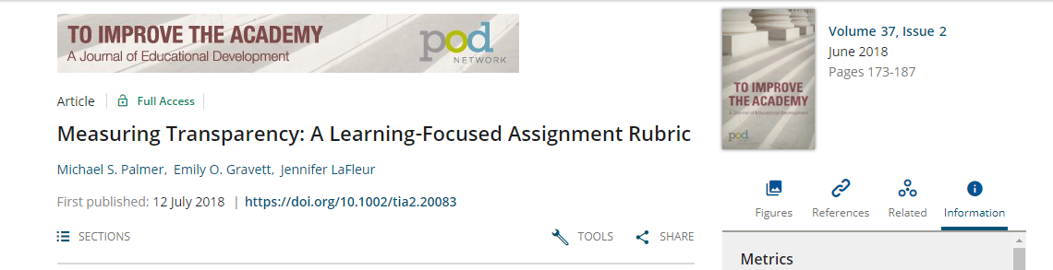
Measuring Transparency
Notes:
Article available at To Improve the Academy website; rubric available at the TILT website
Check out also: TILT checklist and TILT template

Slide 13
Questions or Discussion?
I can be reached at graveteo@jmu.edu for further conversation about transparent assignments!

Slide 14

Develop your teaching your way
Thank you!
support@onehe.org
www.onehe.org

