Slide 1



Develop your teaching your way
AI Boundaries: Setting the Rules of Engagement With Your Students
Lew Ludwig
Todd Zakrasjek
www.onehe.org

Slide 2


Lew Ludwig
Professor of Mathematics
Director, Center for Learning and Teaching
Denison University
Granville, Ohio, USA

Slide 3
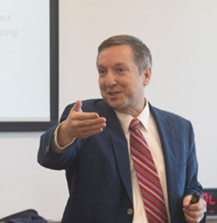
Todd Zakrajšek
Associate Professor
School of Medicine
University of North Carolina
Chapel Hill, North Carolina, USA

Slide 5
Illusion of Consensus
Individuals often implicitly assume others hold the same or similar view with respect to:
Specificity of words or numbers (e.g., often, rarely, infrequent)
Respectful behavior
Expectations of assistance
What is acceptable in academic situations

Slide 6
Illusion of Consensus
Consider a behavior, such as interrupting someone when they are speaking. Assume that when we say Chris always interrupts others during a conversation it means 100% of conversations. If we say never, it means 0% of the time.
What percent of the time would say is “often?”
What percent of the time would say is “some of the time?”

Slide 7



Illusion of Consensus
What is the maximum distance for which you would hold the door open for a person behind you?
Source: OpenAI. (2025). A realistic illustration of a person holding a door open for another person [AI-generated image]. DALL·E. https://chat.openai.com
Please draw another image with the second person further away and the individuals are entering a building.
Getting there. The word entrance over the door is not spelled correctly and the individual holding the door is not actually holding the door. Plus, there is nobody behind the person holding the door...they are in front. Let's try a realistic view of a person holding a door open for another approaching individual who is also entering the building.

Slide 8
Expected Student Behavior
It is imperative that faculty members consider implications of language that is vague.
This is particularly important for aspects of a course with high potential impact:
Examinations
Acceptance of late assignments (and what is considered late).
Use of outside sources when writing papers or completing assignments.

Slide 9
How to start a productive conversation with your students about AI.

Slide 10

How to start a productive conversation with your students about AI.

Slide 11
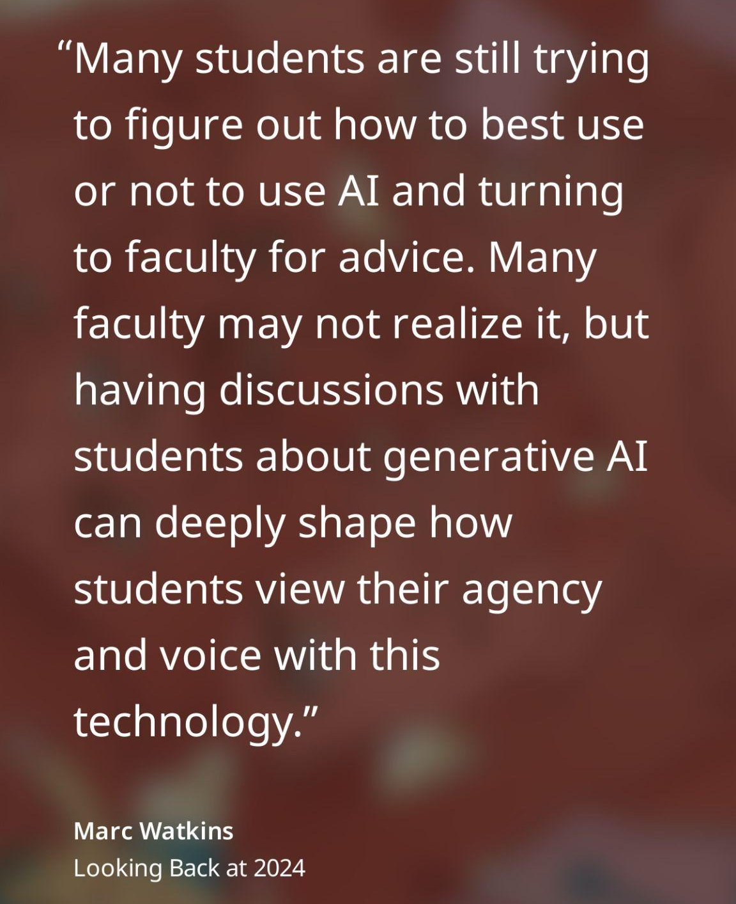
How to start a productive conversation with your students about AI.

Slide 12

An AI Engagement Scale

Slide 13
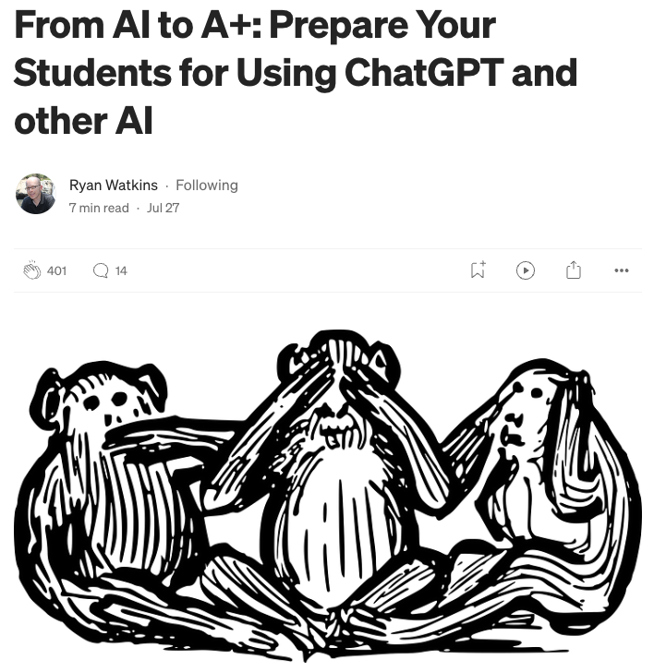
An AI Engagement Scale
Link to article by Ryan Watkins

Slide 14
An AI Engagement Scale ESSAY EXAMPLE

Slide 15
An AI Engagement Scale ESSAY EXAMPLE
At which point on the progressive list below could a student use AI to assist in completing an essay assignment WITHOUT crossing "the line" that violates academic integrity in this course?

Slide 16
Assist in completing an essay assignment
Idea Generation: Brainstorm essay topics using AI based on assignment guidelines.
Title Suggestion: AI helps create a relevant and engaging title for the essay.
Outline Creation: Structure essay outlines with AI, outlining key points for each section.
Research Guidance: AI directs potential research areas (cannot perform actual research).
Draft Writing: AI assists in writing initial drafts using outlines and research insights.
Revision Suggestions: AI provides feedback to refine the draft, focusing on clarity.
Proofreading: AI checks for grammatical errors and punctuation.
Style Refinement: AI ensure the essay's style is appropriate for academic settings.
Final Review: AI reviews the essay's coherence, structure, and persuasiveness.
Complete Essay Writing: AI compiles the entire essay from provided details and research.

Slide 17

Zoom cascade
After reading the choices, type your response into the Zoom chat BUT DO NOT PRESS ENTER
We will press enter together on the count of three

Slide 18
Assist in completing an essay assignment
Idea Generation: Brainstorm essay topics using AI based on assignment guidelines.
Title Suggestion: AI helps create a relevant and engaging title for the essay.
Outline Creation: Structure essay outlines with AI, outlining key points for each section.
Research Guidance: AI directs potential research areas (cannot perform actual research).
Draft Writing: AI assists in writing initial drafts using outlines and research insights.
Revision Suggestions: AI provides feedback to refine the draft, focusing on clarity.
Proofreading: AI checks for grammatical errors and punctuation.
Style Refinement: AI ensure the essay's style is appropriate for academic settings.
Final Review: AI reviews the essay's coherence, structure, and persuasiveness.
Complete Essay Writing: AI compiles the entire essay from provided details and research.

Slide 19

Assist in completing an essay assignment
Idea Generation: Brainstorm essay topics using AI based on assignment guidelines.
Title Suggestion: AI helps create a relevant and engaging title for the essay.
Outline Creation: Structure essay outlines with AI, outlining key points for each section.
Research Guidance: AI directs potential research areas (cannot perform actual research).
Draft Writing: AI assists in writing initial drafts using outlines and research insights.
Revision Suggestions: AI provides feedback to refine the draft, focusing on clarity.
Proofreading: AI checks for grammatical errors and punctuation.
Style Refinement: AI ensure the essay's style is appropriate for academic settings.
Final Review: AI reviews the essay's coherence, structure, and persuasiveness.
Complete Essay Writing: AI compiles the entire essay from provided details and research.

Slide 20
An AI Engagement Scale
Six example survey scales. Assist in
Completing an essay assignment
Taking an exam, test, or quiz
Writing a literature review
Completing a collaborative project
Coding project
Completing a data analysis research
Link to article by Ryan Watkins

Slide 21
An AI Engagement Scale
Six example survey scales
Assist in completing an essay assignment
Assist in taking an exam, test, or quiz
Assist in writing a literature review
Assist in completing a collaborative project
Assist in completing a coding project
Assist in completing a data analysis research
But what if these examples don’t work for my class?
Link to article by Ryan Watkins

Slide 22
Use AI to create an AI Engagement Scale
STEPS:
Give AI an example of Watkins’ scale
Tell AI what you want it to do:
  Give it a role
  Tell it about your class
  Tell it what you want it to produce/format
  Share the assignment with AI
Link to the example chat: https://chatgpt.com/share/67c71ce1-f3d0-8008-aaa7-8c6259f6650a

Slide 23

Use AI to create an AI Engagement Scale
Now you have a concrete example (practical illustration) to poll your students, then begin a discussion on what is acceptable use.

Slide 24
Use AI to create an AI Engagement Scale
Now you have a concrete example (practical illustration) to poll your students, then begin a discussion on what is acceptable use.
But how are your students going to put this to use? What prompts should they use?

Slide 25

Use AI to create Engagement Scale Prompts
Use AI to create
the prompts!
Link to the example chat: https://chatgpt.com/share/67cda93f-3a64-8008-8dd4-bf6b2e287830

Slide 26
Recap:AI engagement scale
Create an AI Engagement Scale for an assignment
Rate your acceptance on the AI Engagement Scale
Have students rate the AI Engagement Scale
Engage your students in a discussion
Develop & share Guided AI Prompting
Revisit, do more than once

Slide 27

What teaching used to be.

Slide 28

How Teaching used to be.
How teaching feels right now.

Slide 29

Develop your teaching your way
Thank you!
support@onehe.org
www.onehe.org

